Slide 1
2004 Cross-shelf
28/11/2019

Slide 2
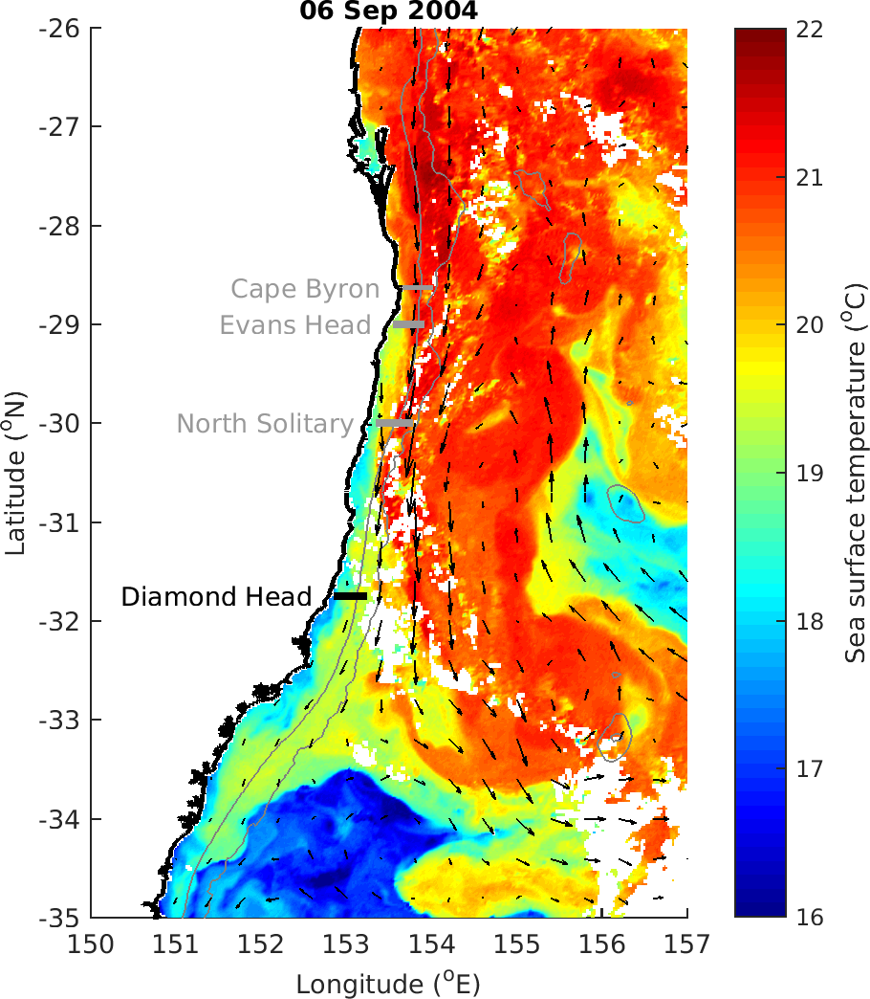

Slide 3
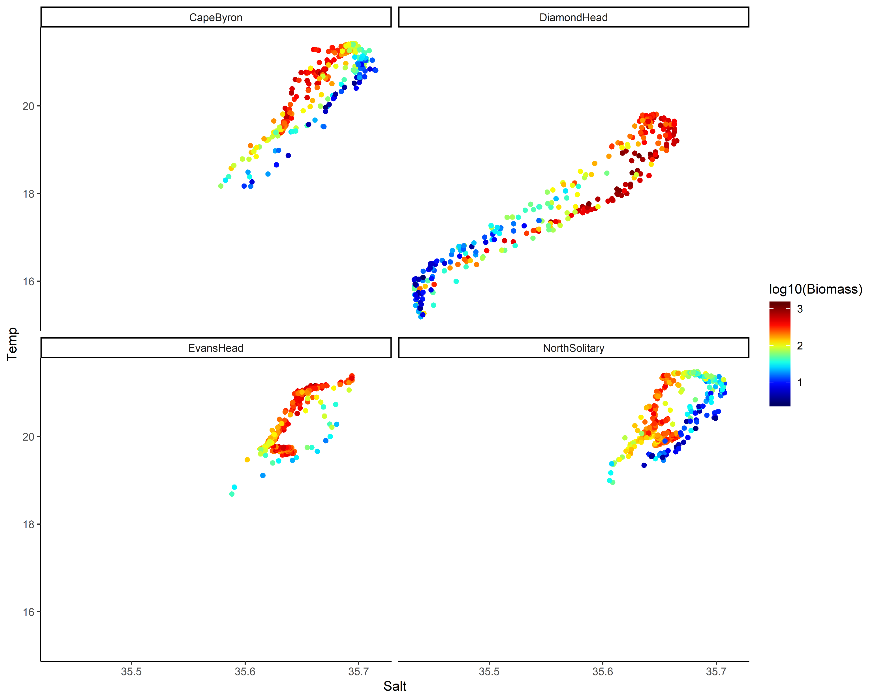
TS Plot by log₁₀(Biomass)

Slide 4
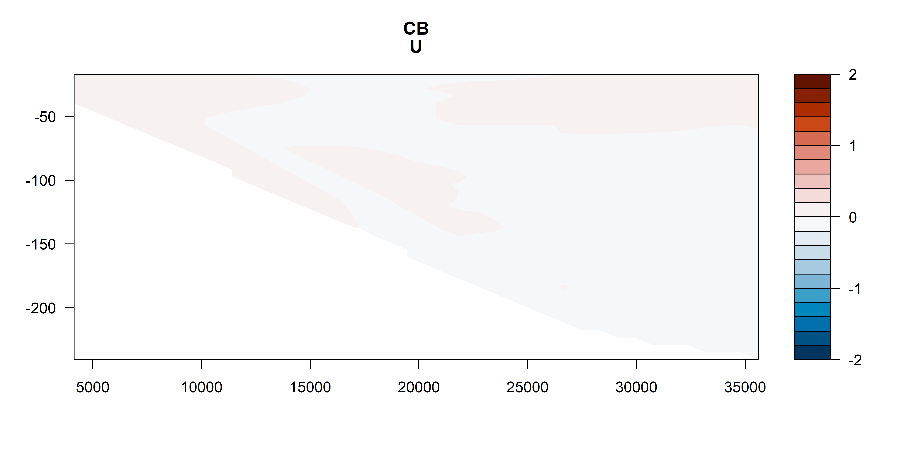
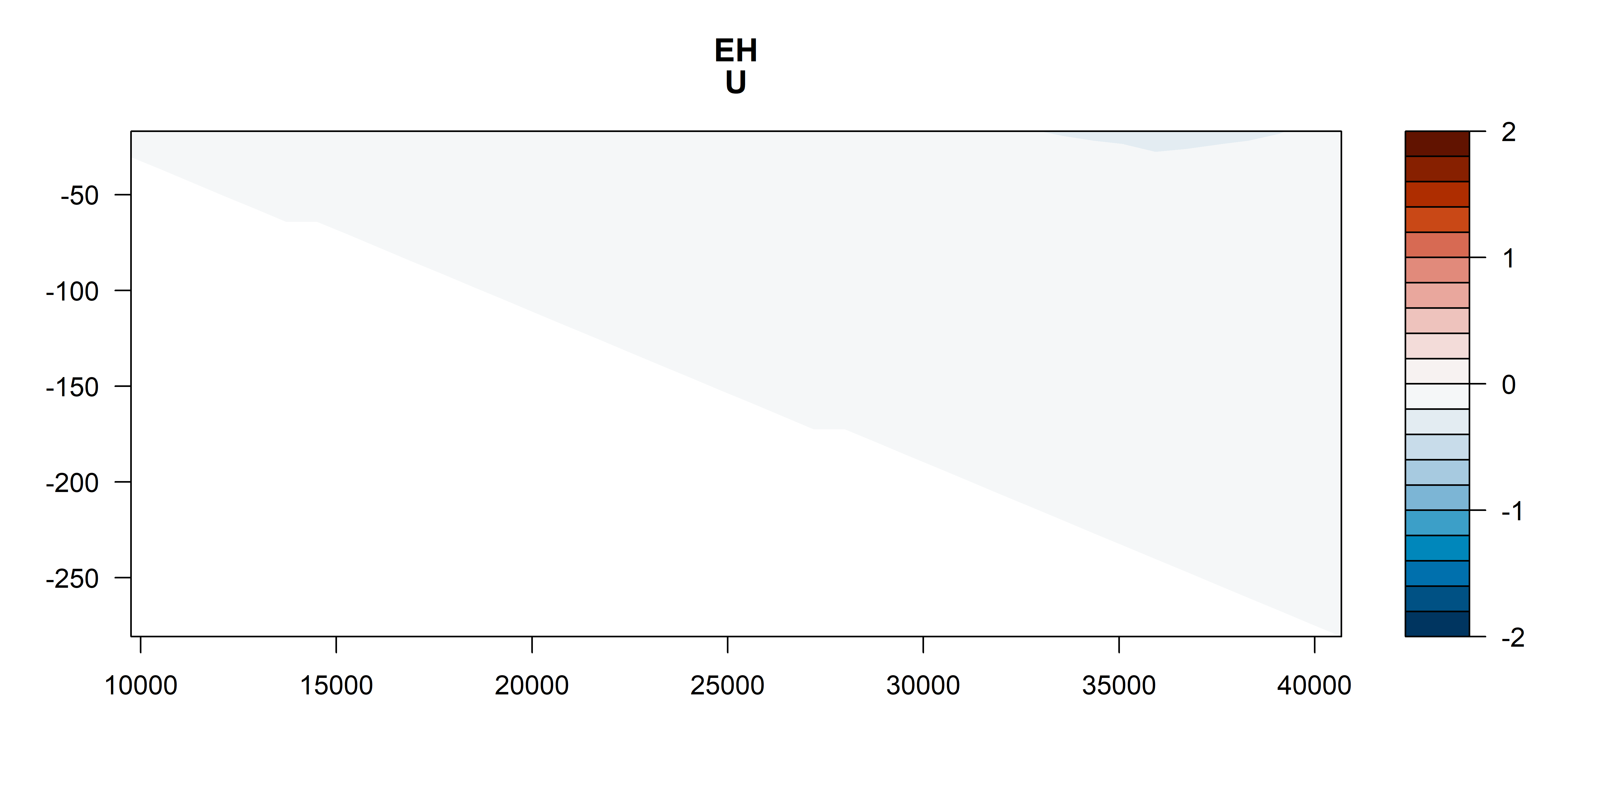
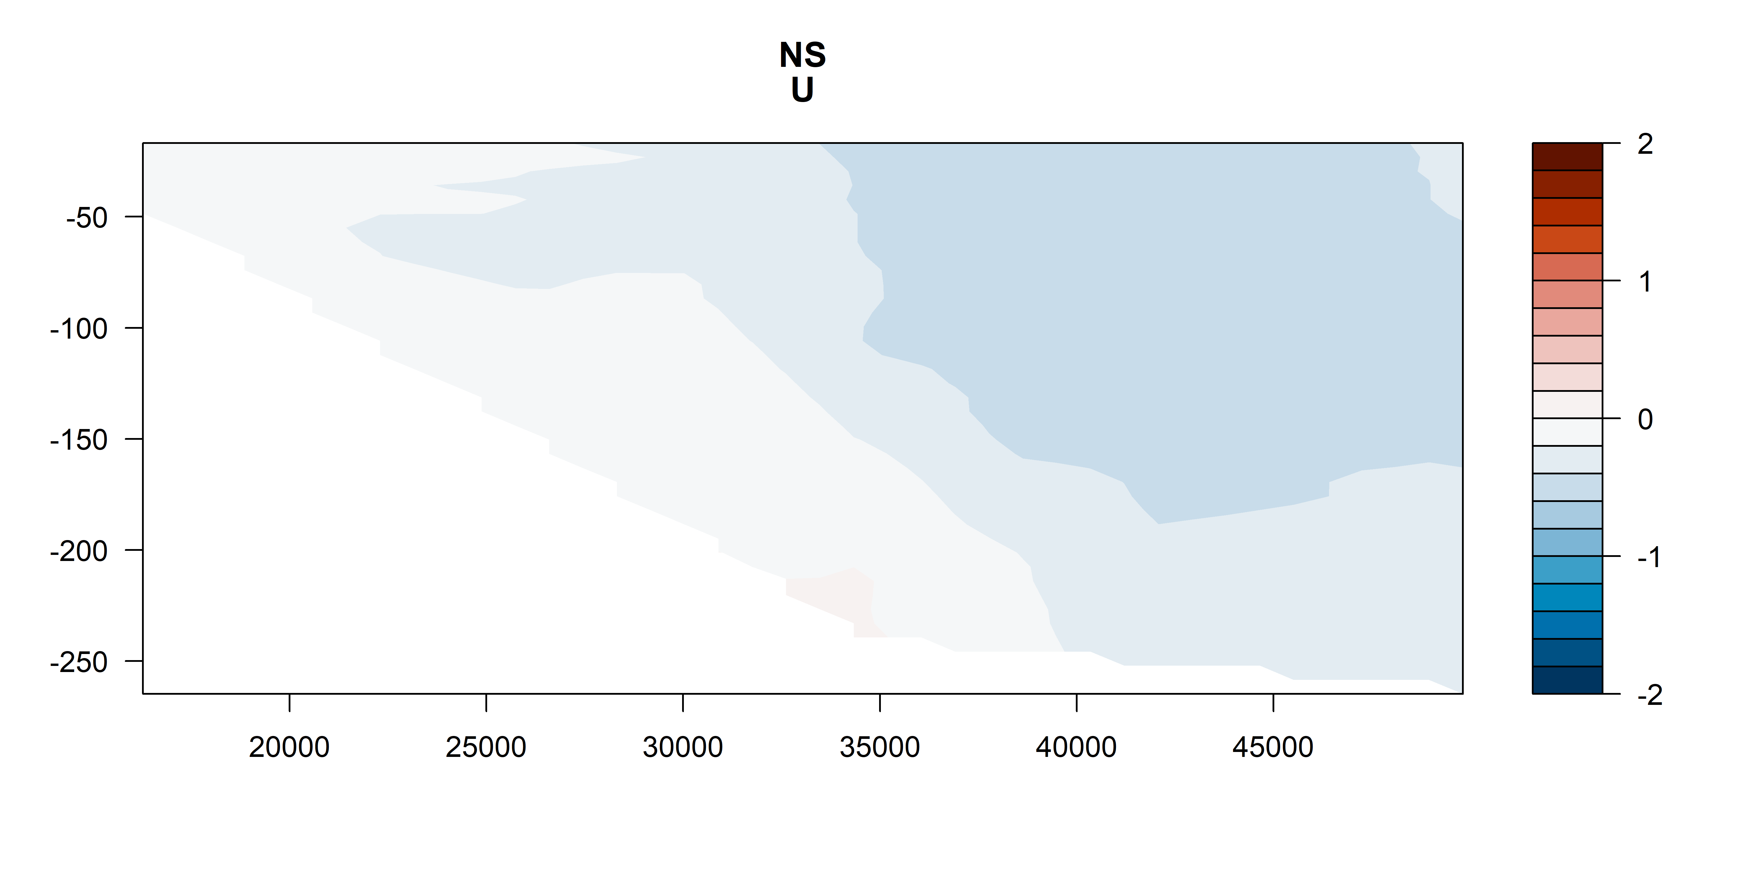
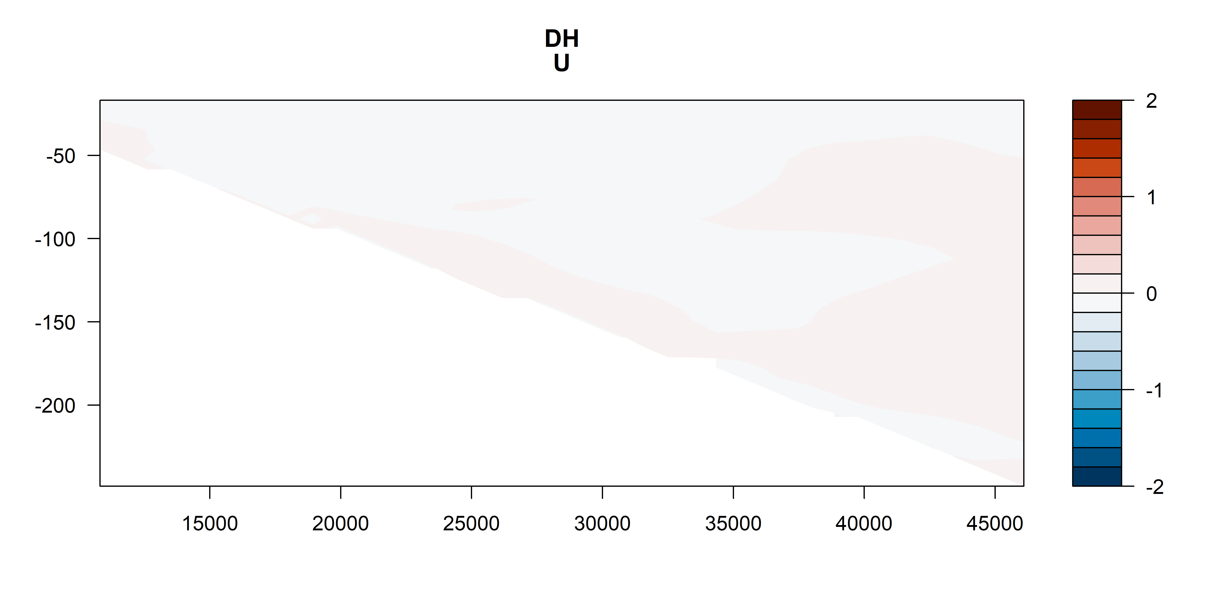
U vectors
m s⁻¹
m s⁻¹
m s⁻¹
m s⁻¹

Slide 5
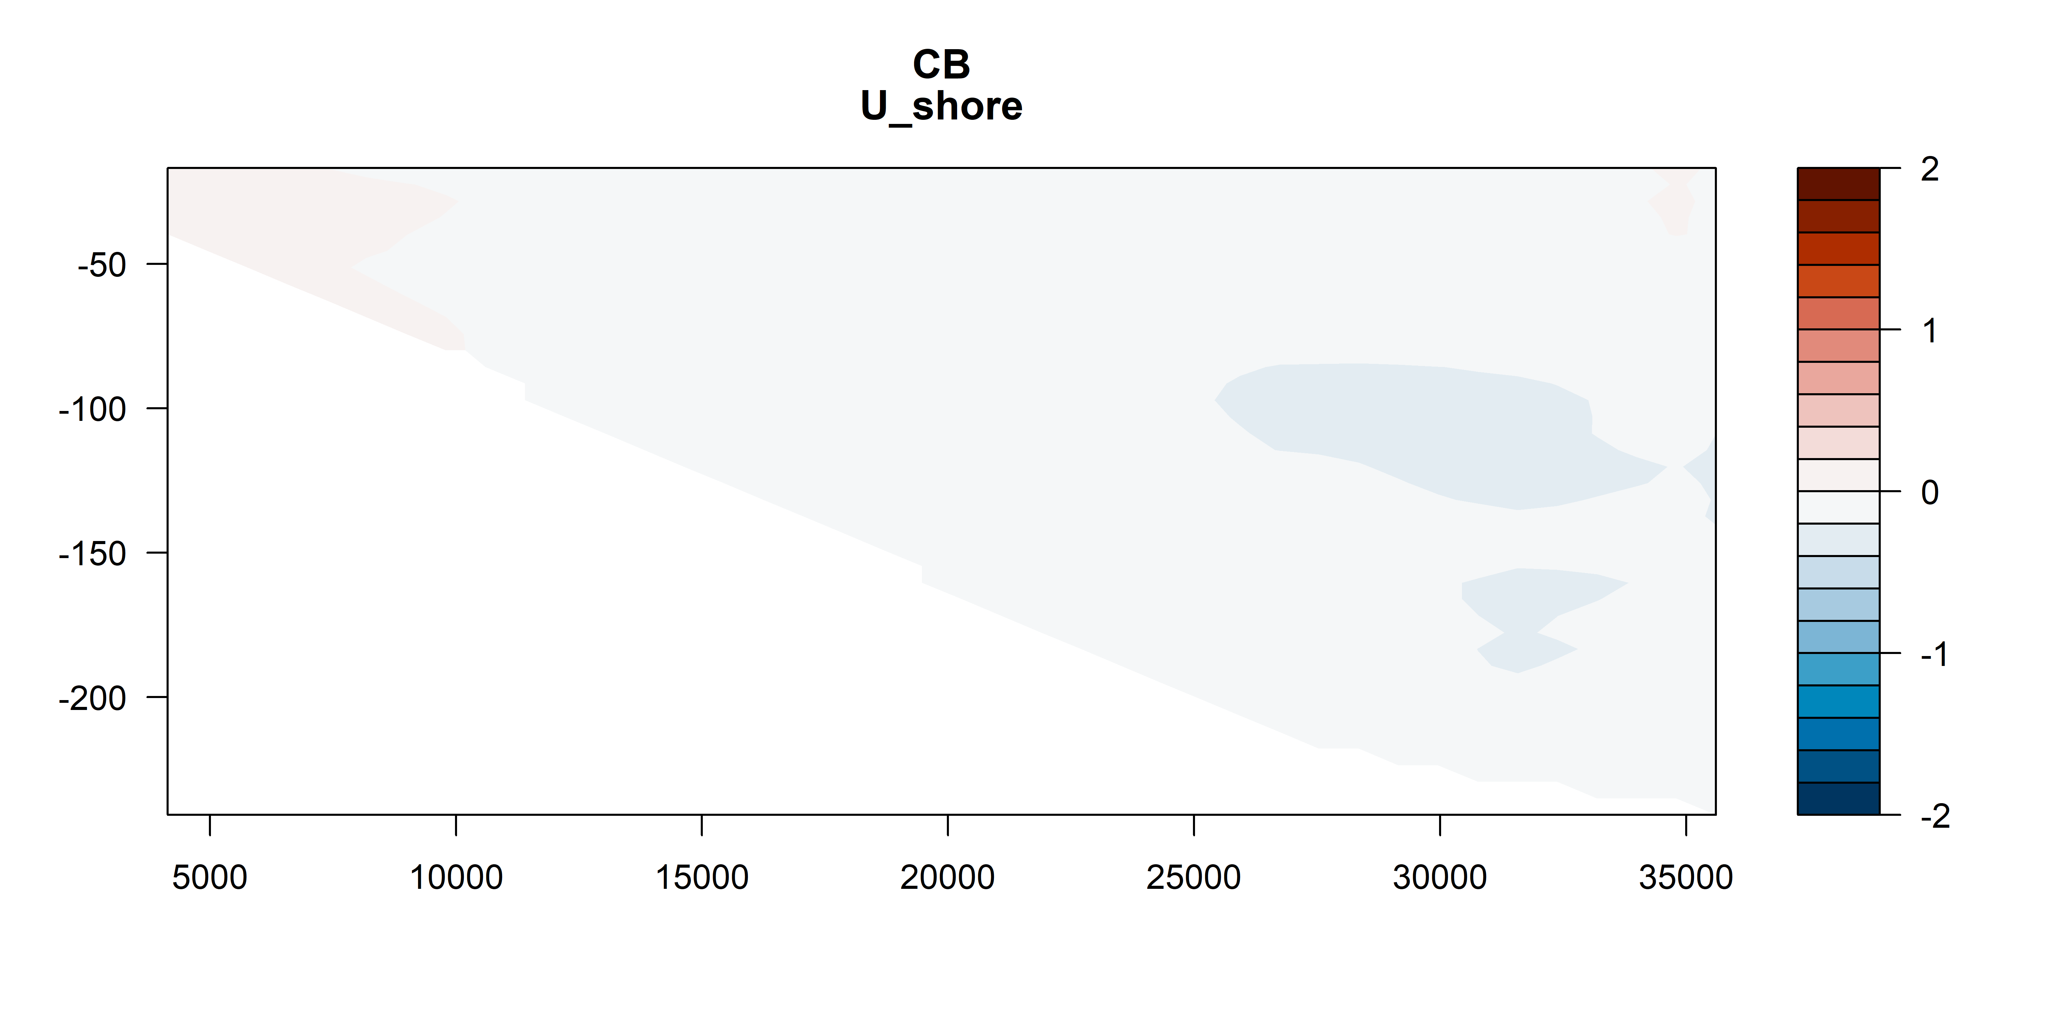
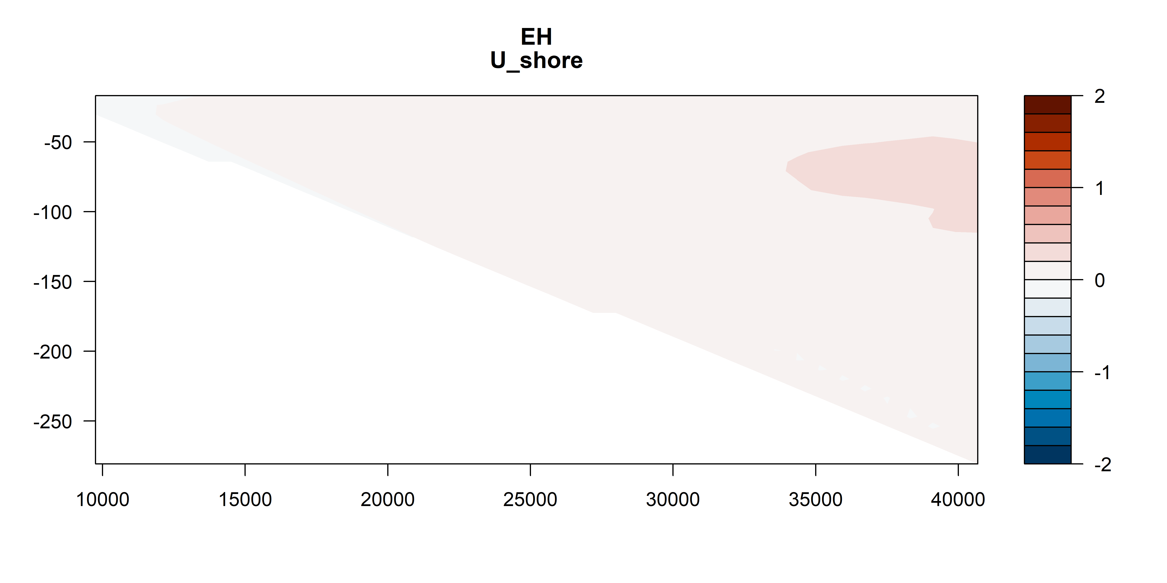
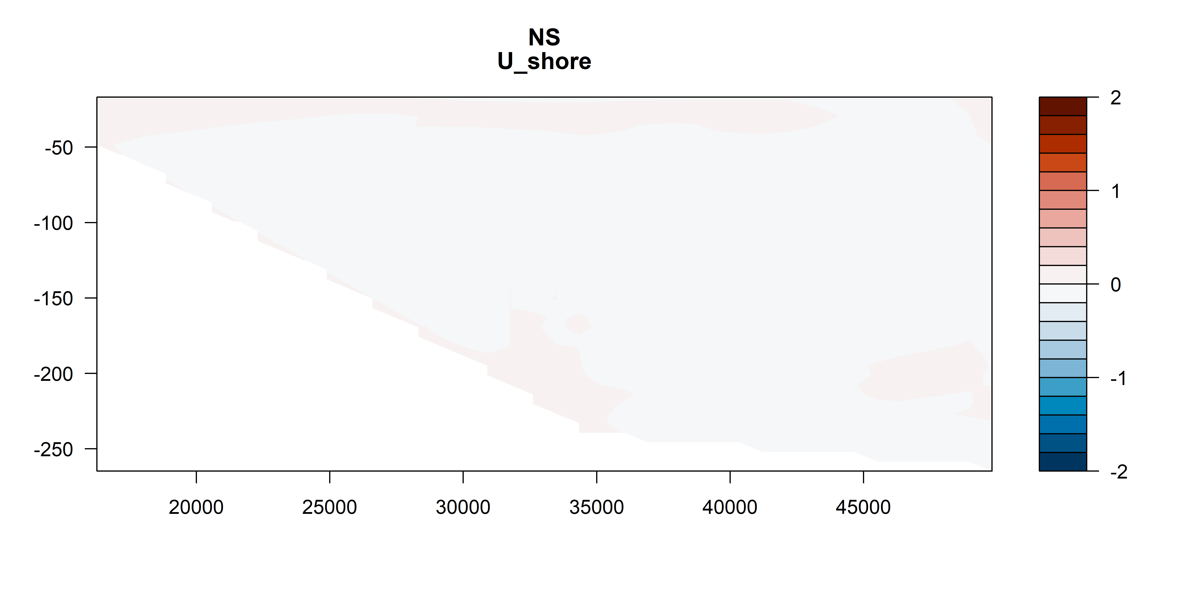
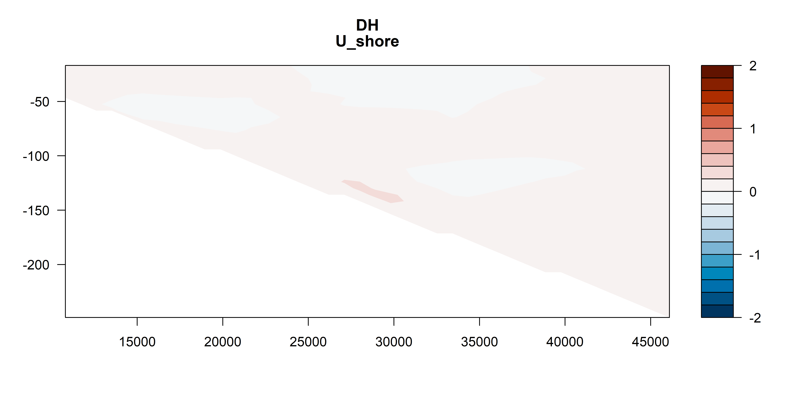
U vectors – shoreline rotated
m s⁻¹
m s⁻¹
m s⁻¹
m s⁻¹

Slide 6
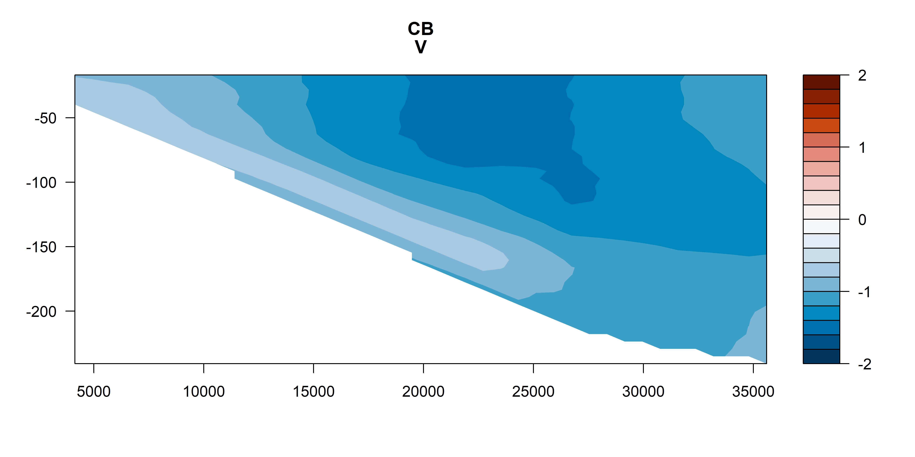
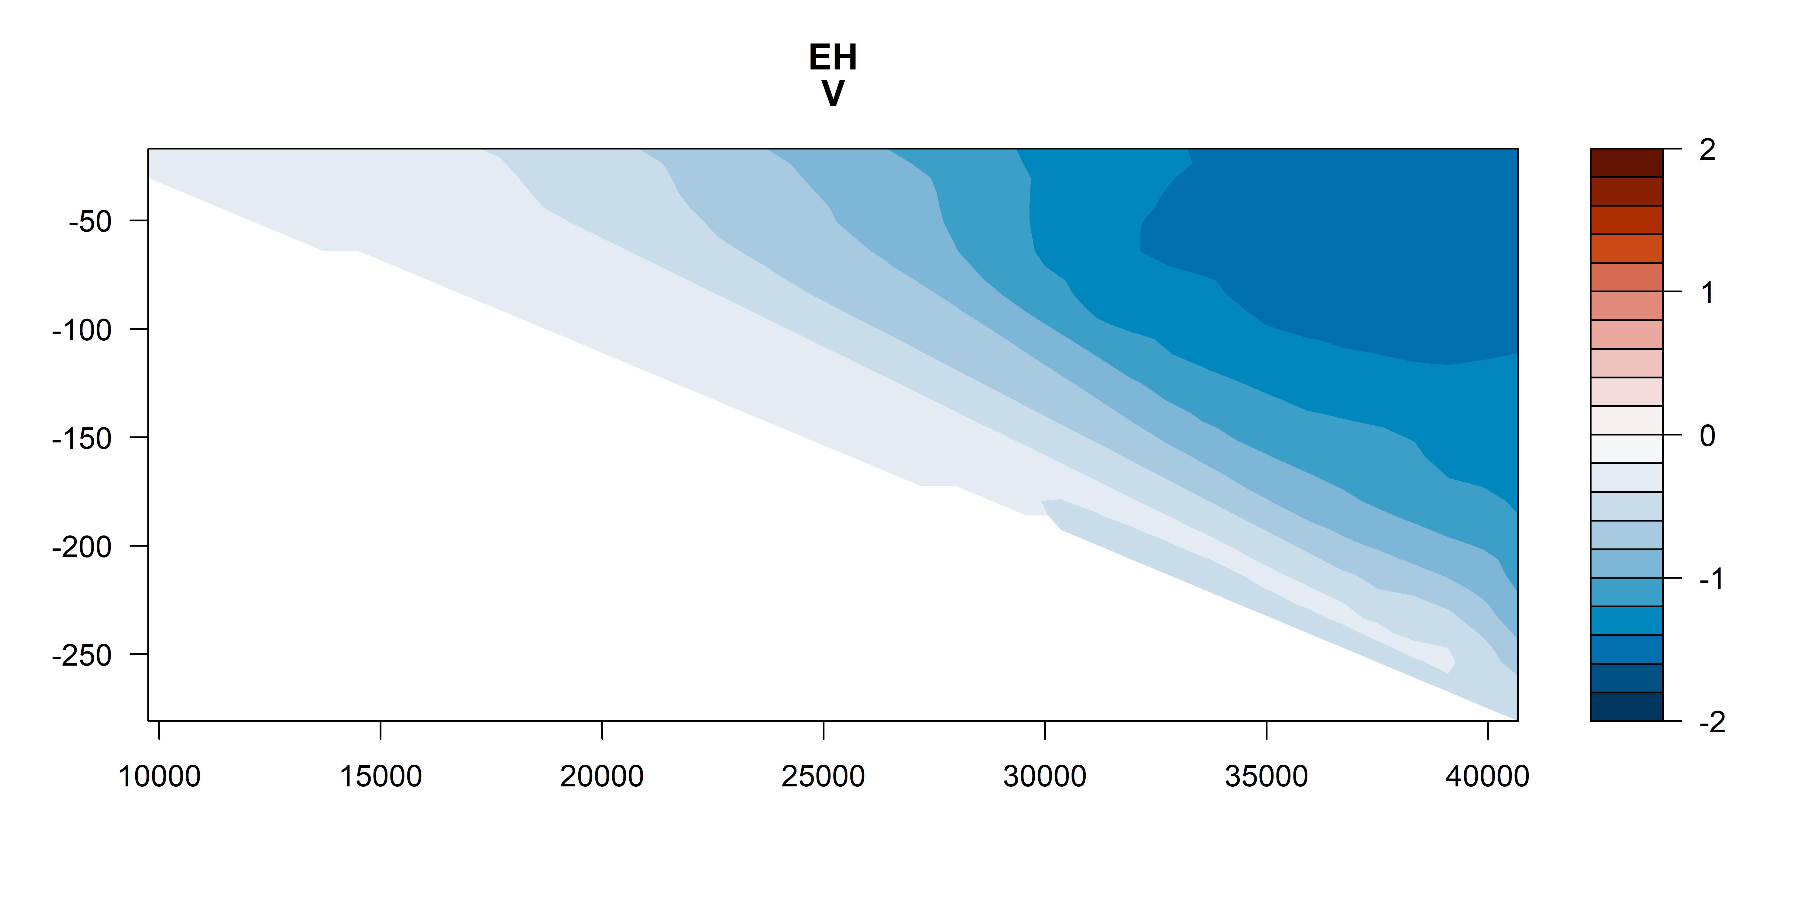
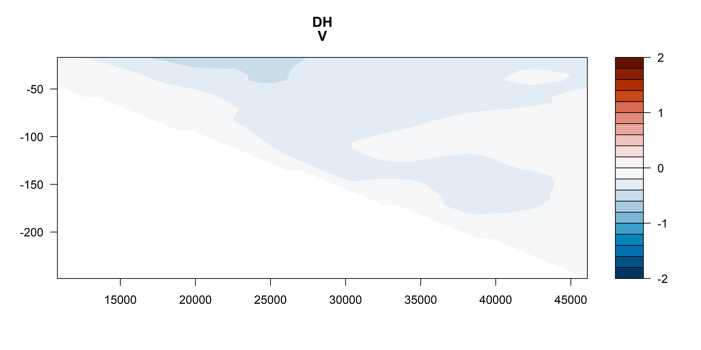
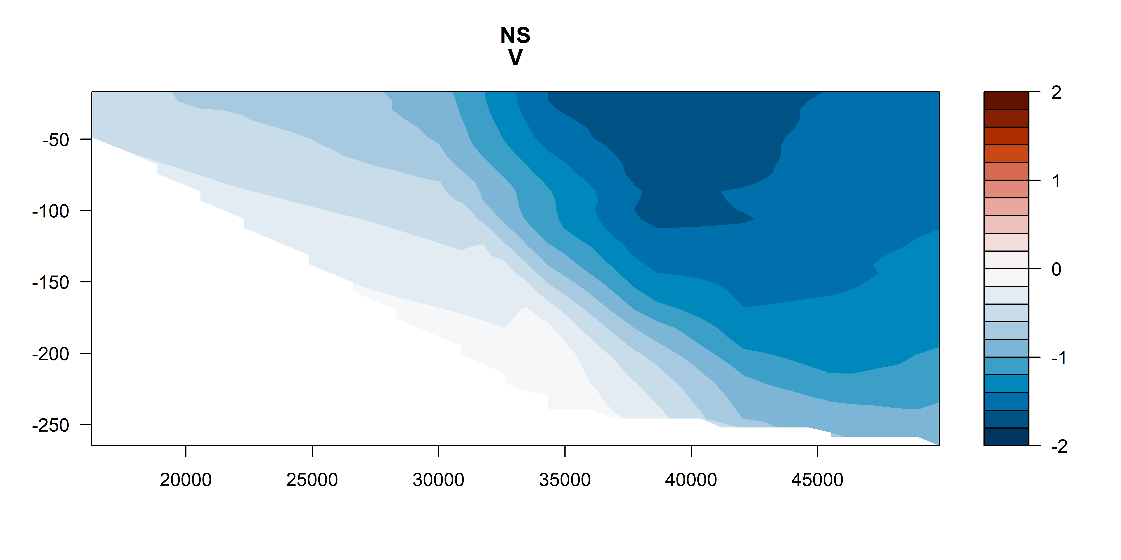
V vectors
m s⁻¹
m s⁻¹
m s⁻¹
m s⁻¹

Slide 7
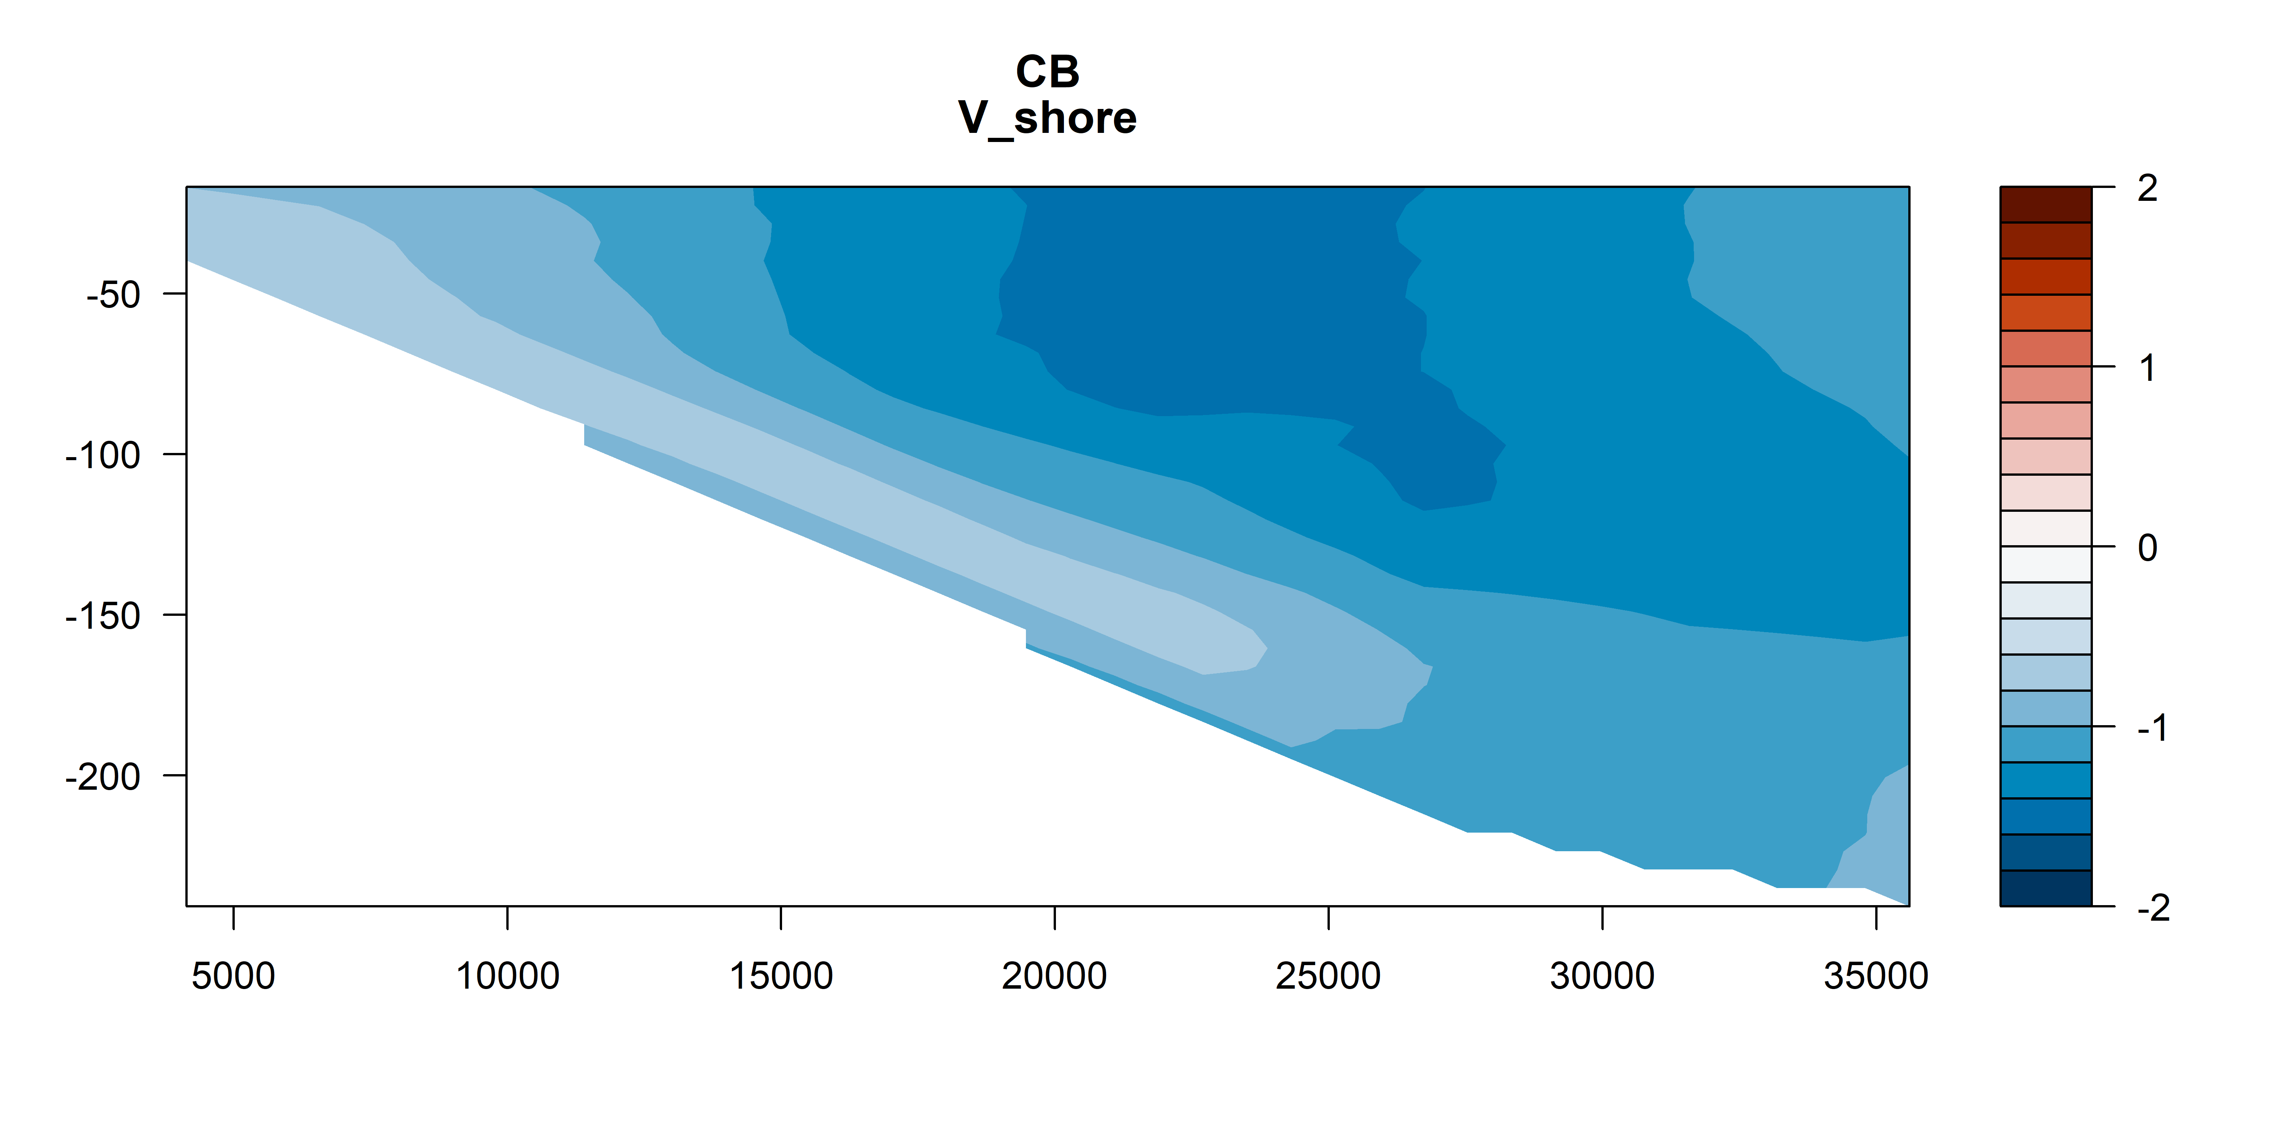
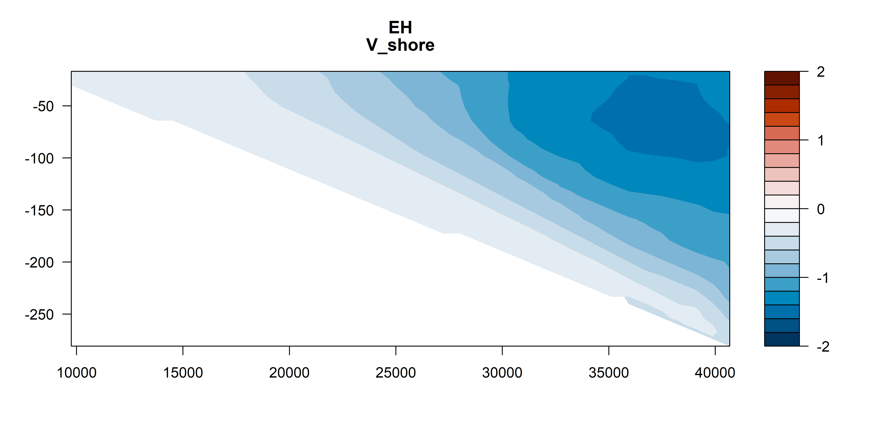
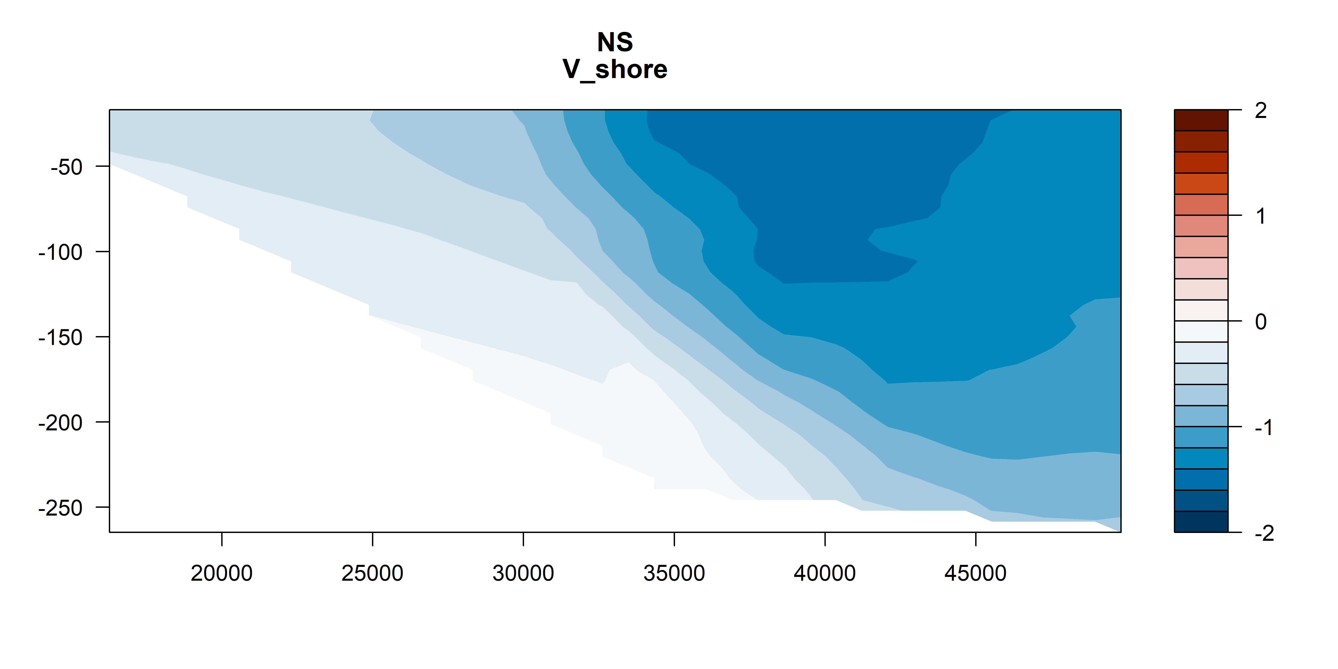
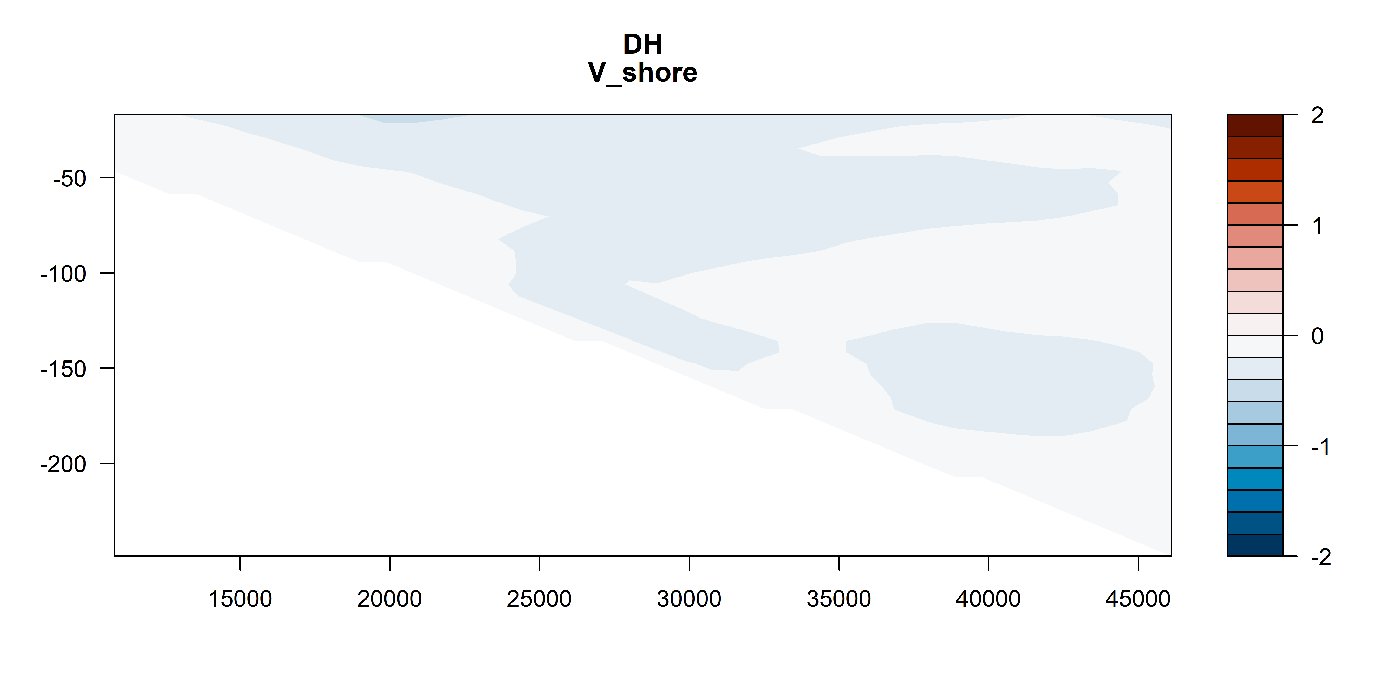
V vectors – shoreline rotated
m s⁻¹
m s⁻¹
m s⁻¹
m s⁻¹

Slide 8
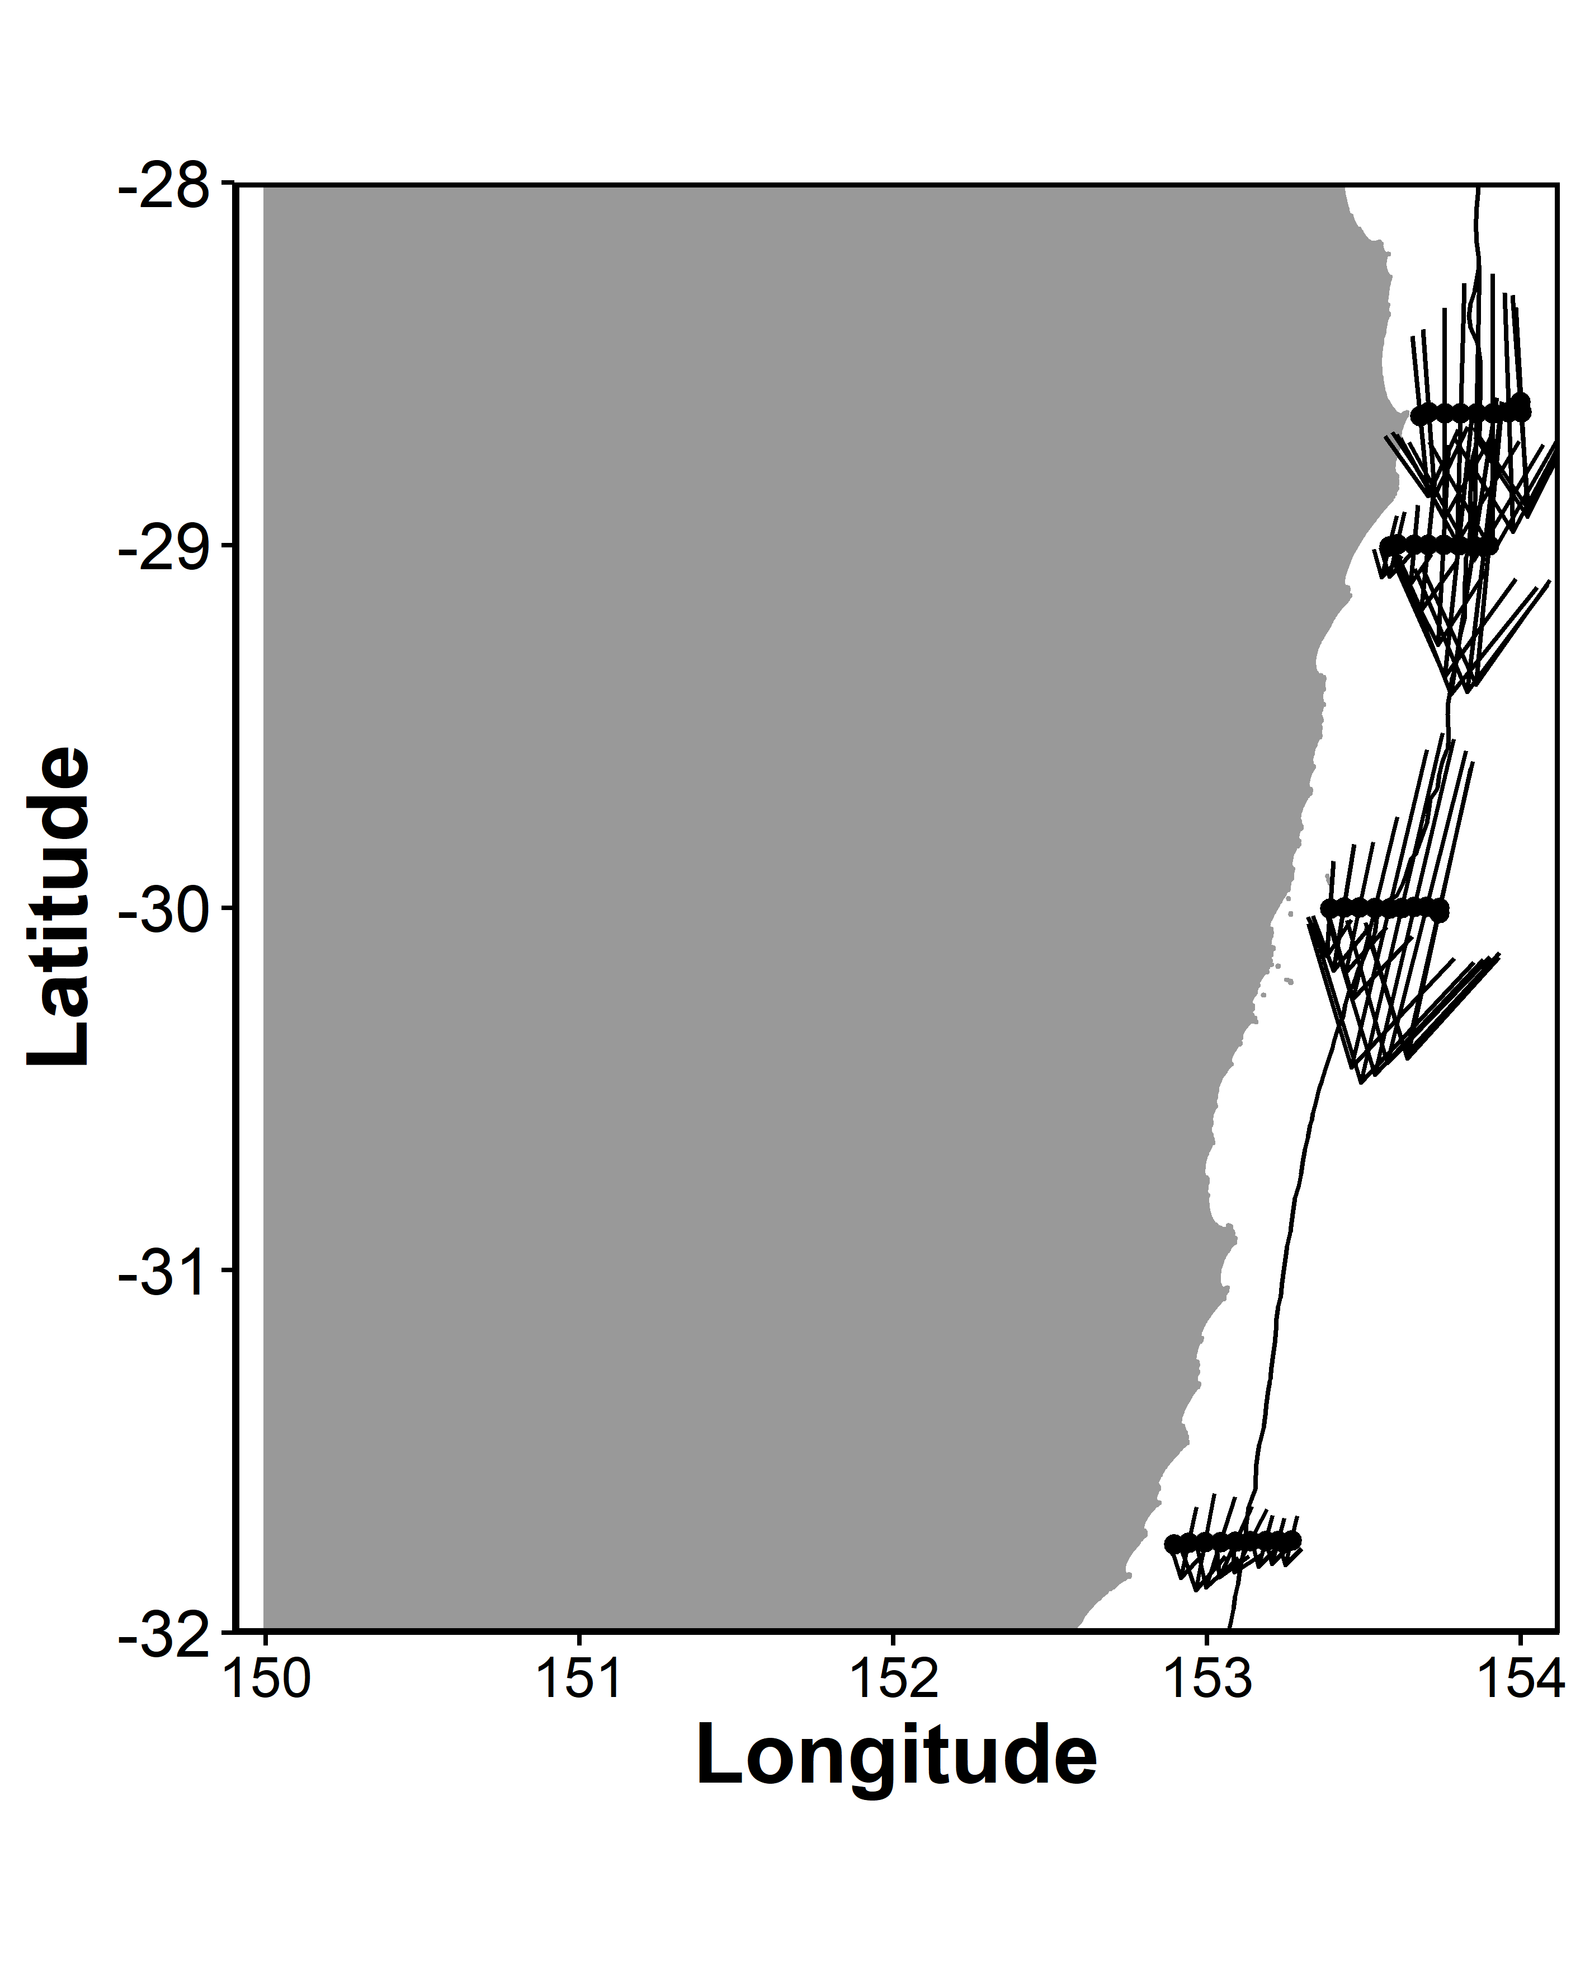
ADCP Velocity on a map

Slide 9
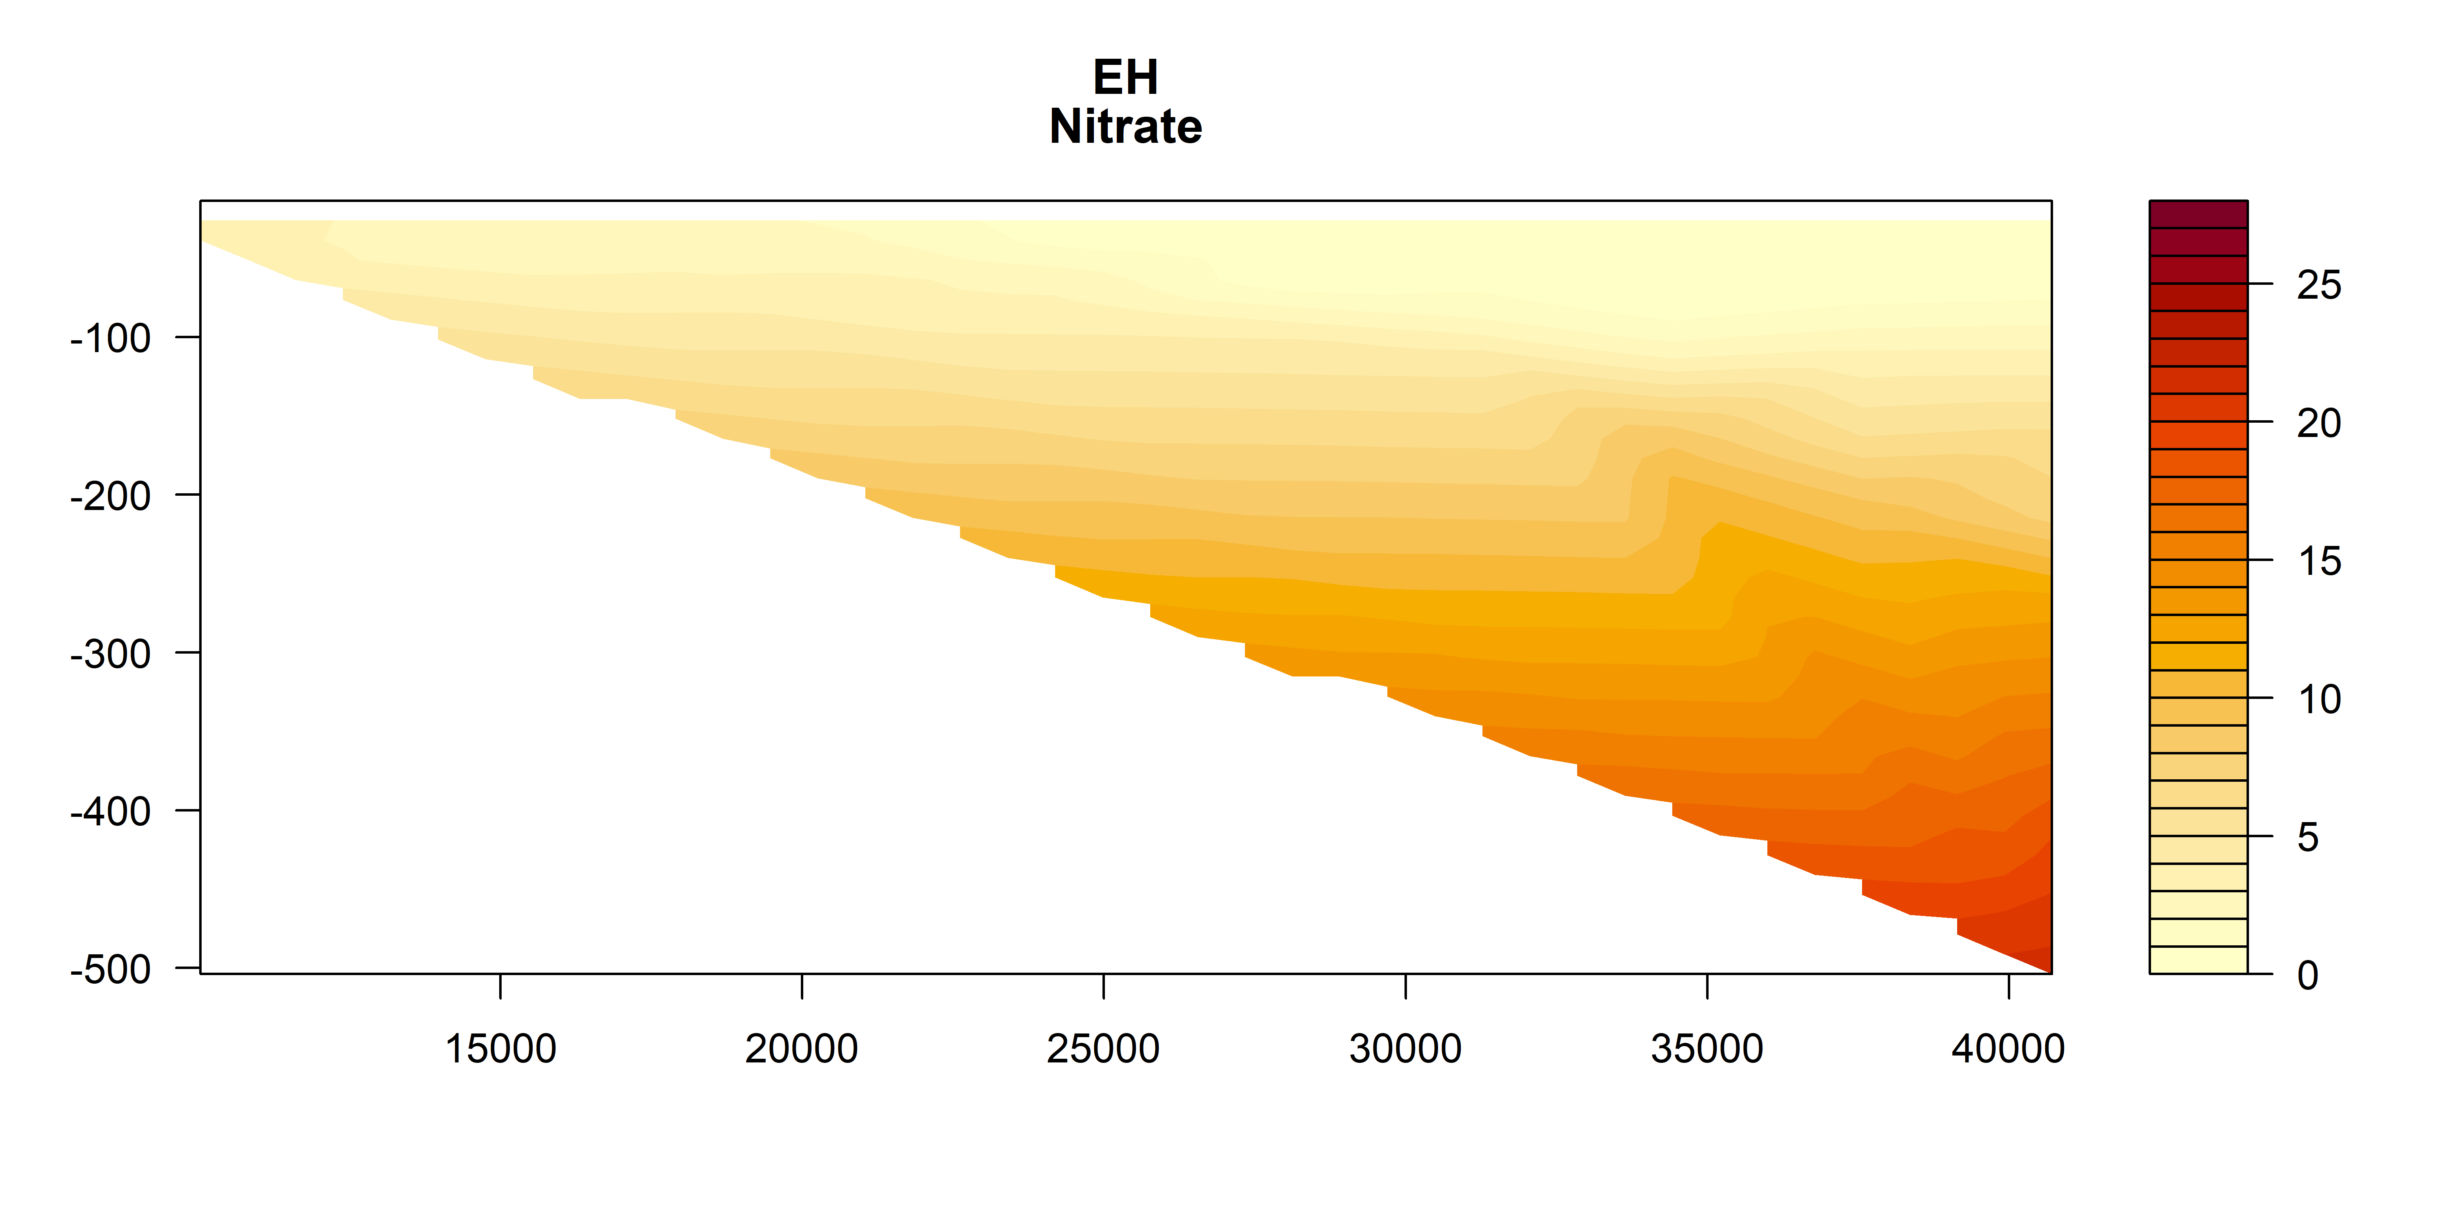
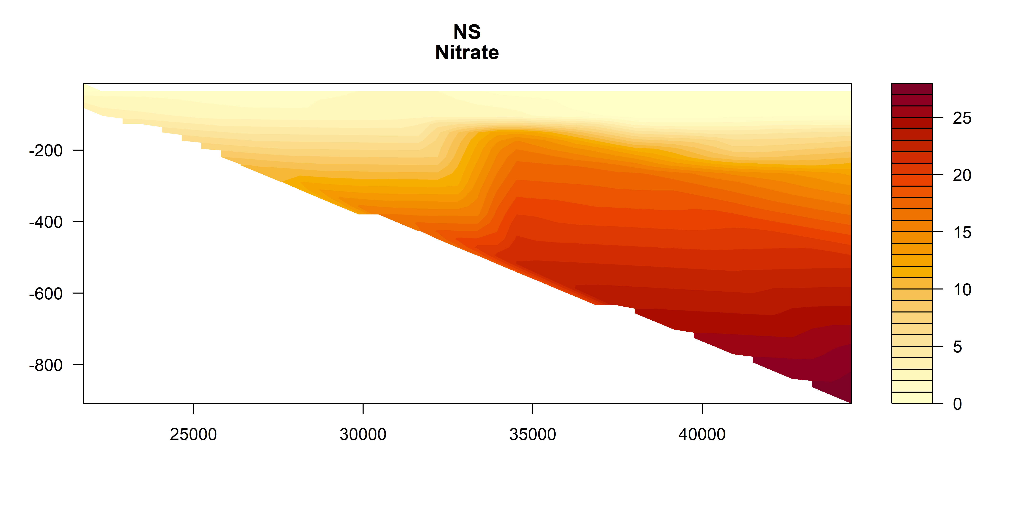
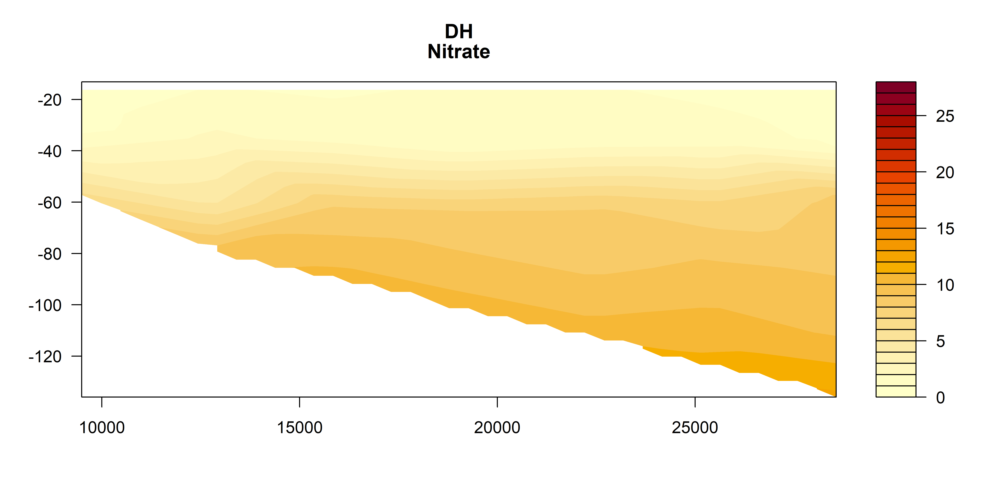
Nitrate

Slide 10
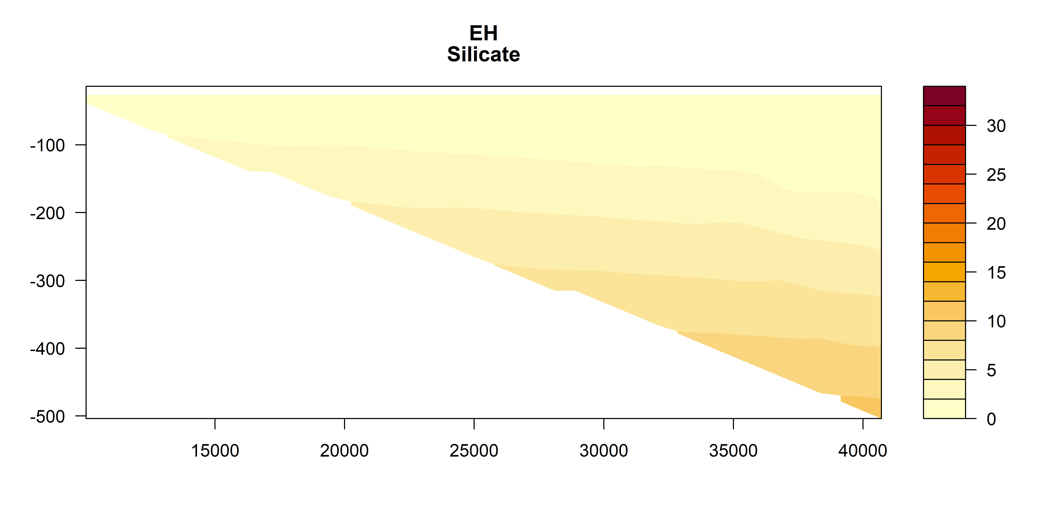
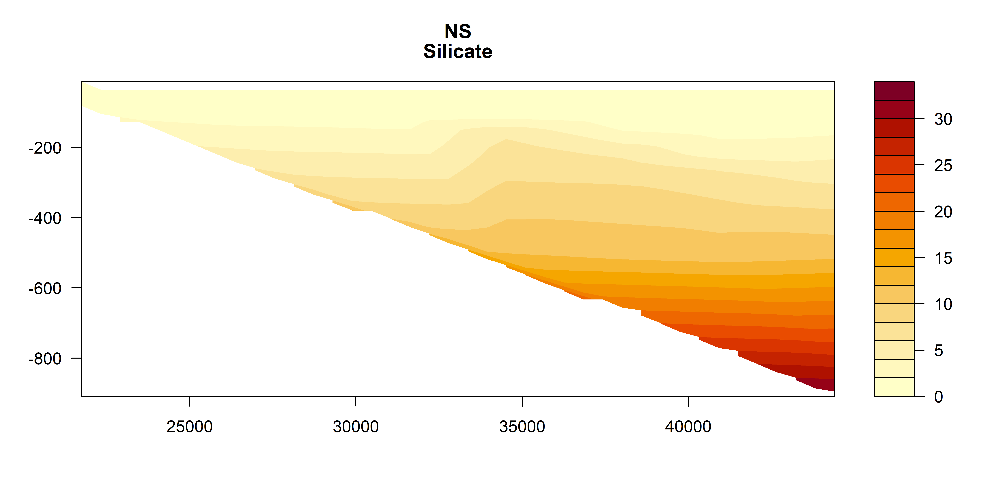
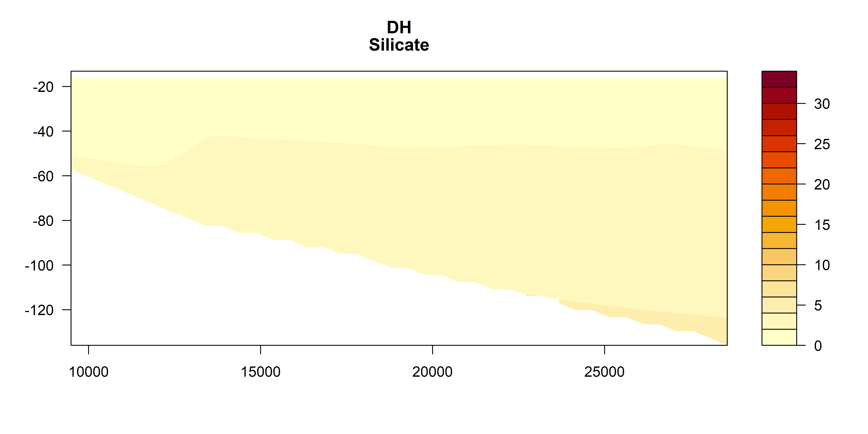
Silicate

Slide 11
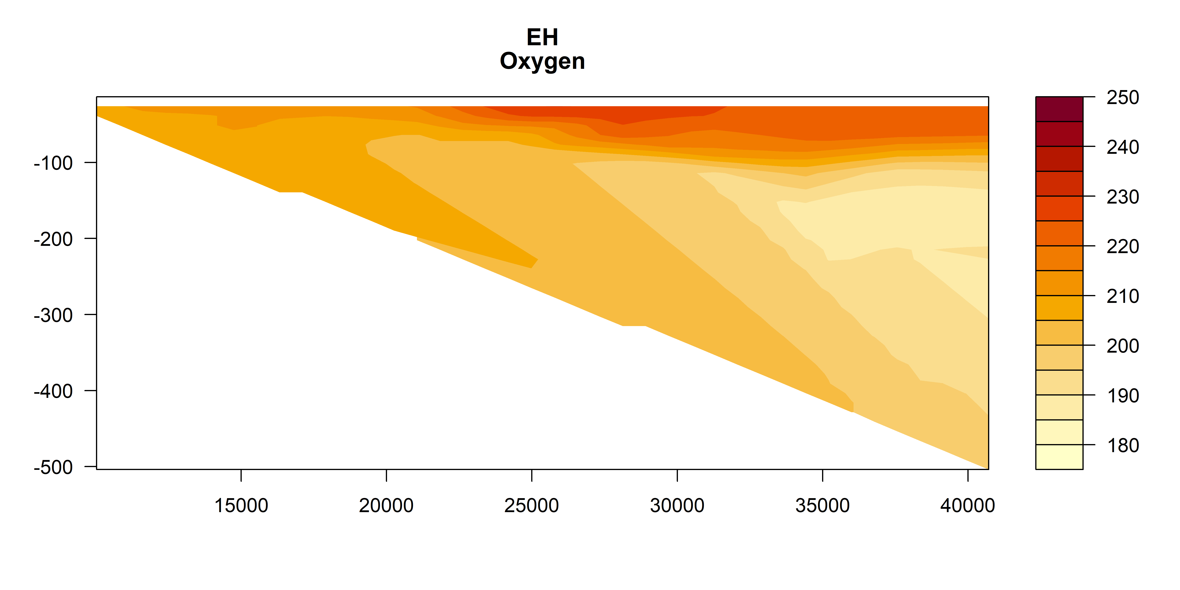
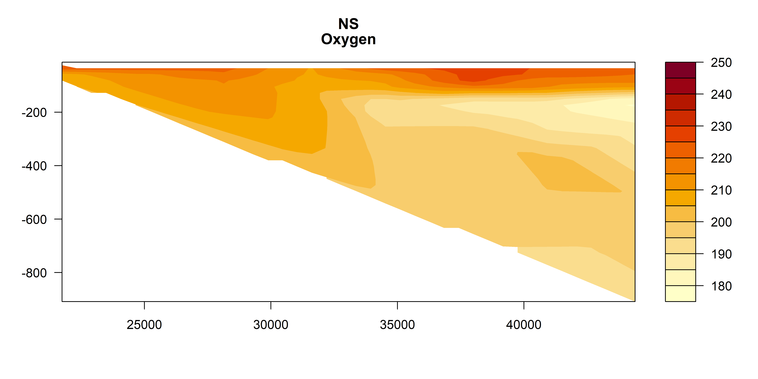
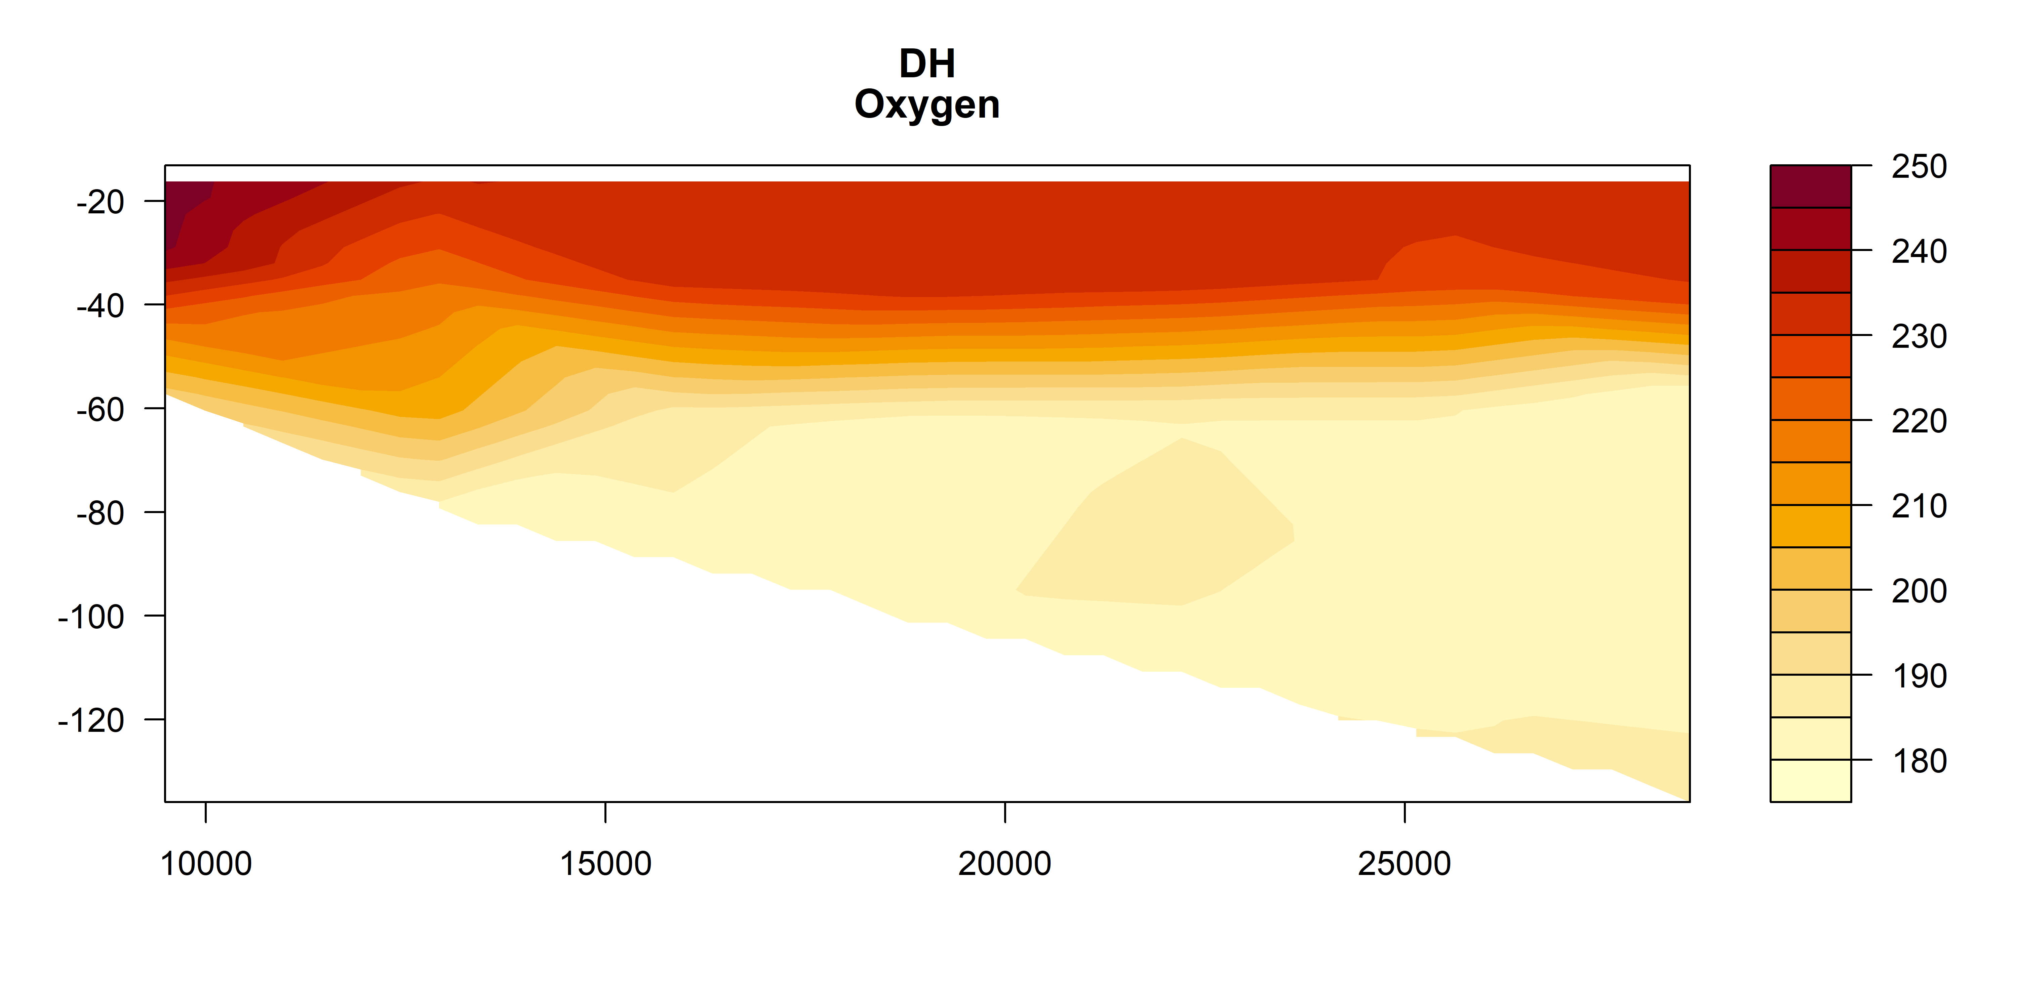
Oxygen

Slide 12
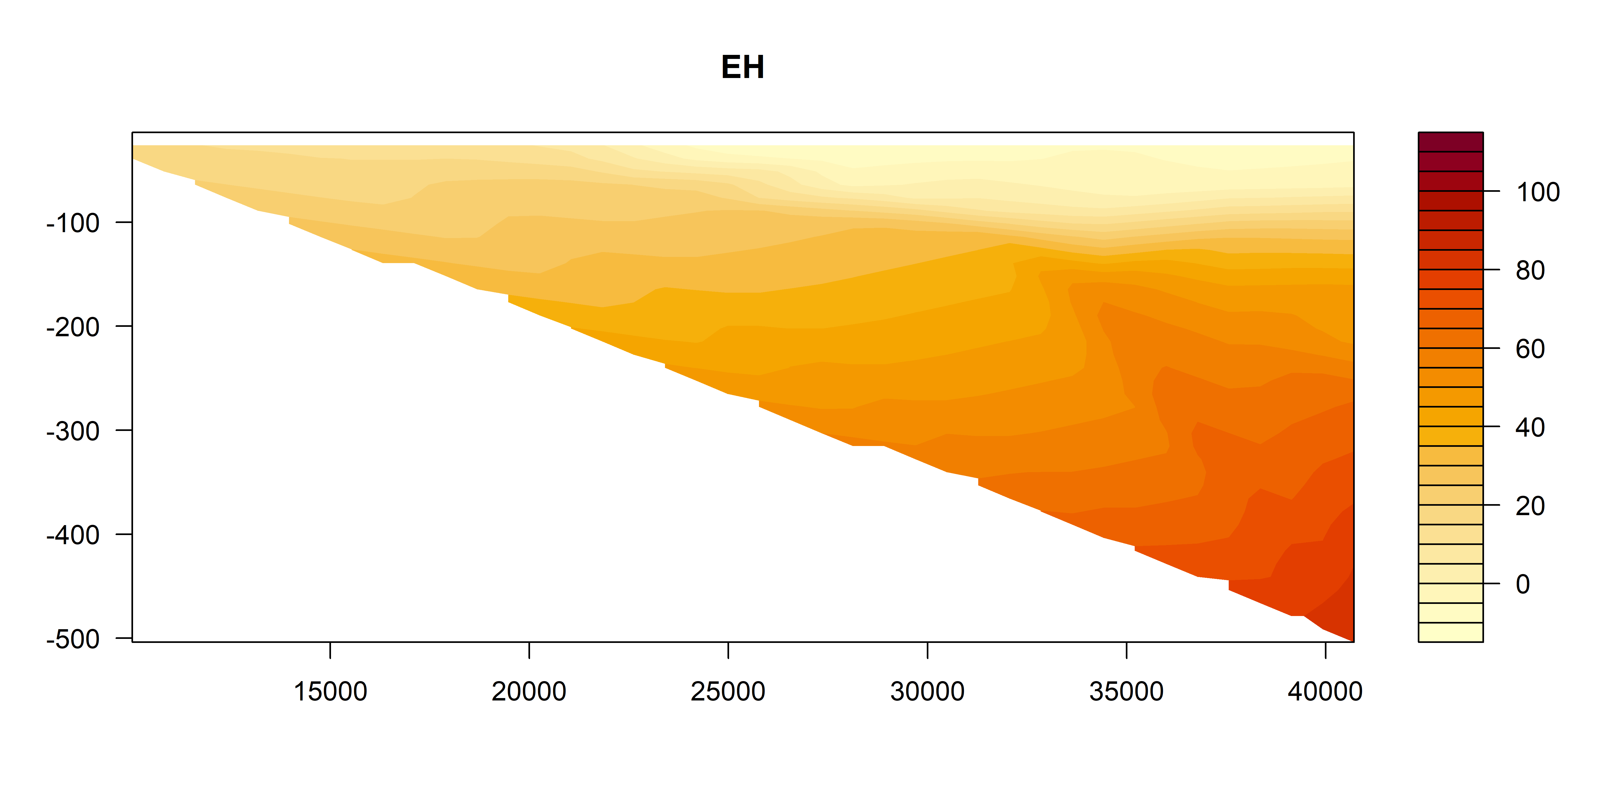
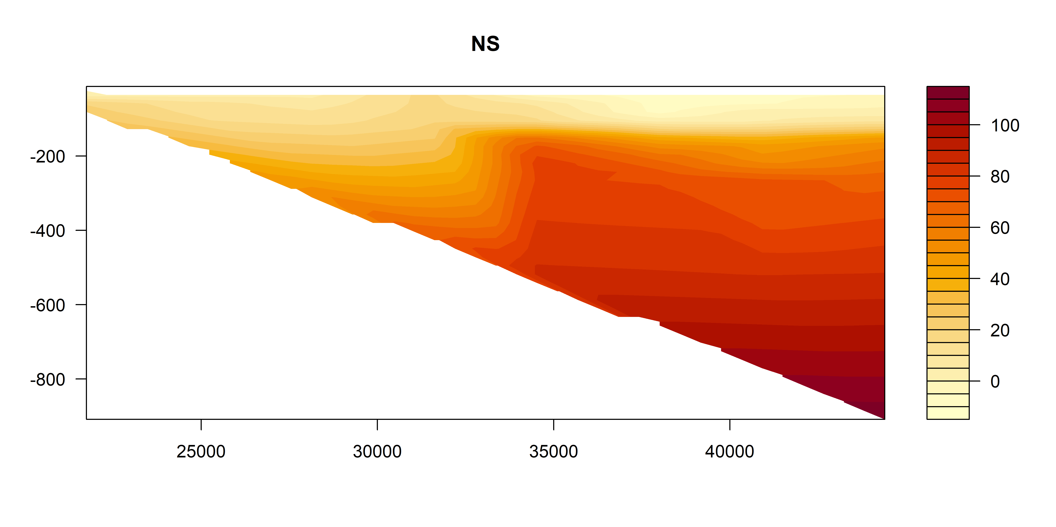
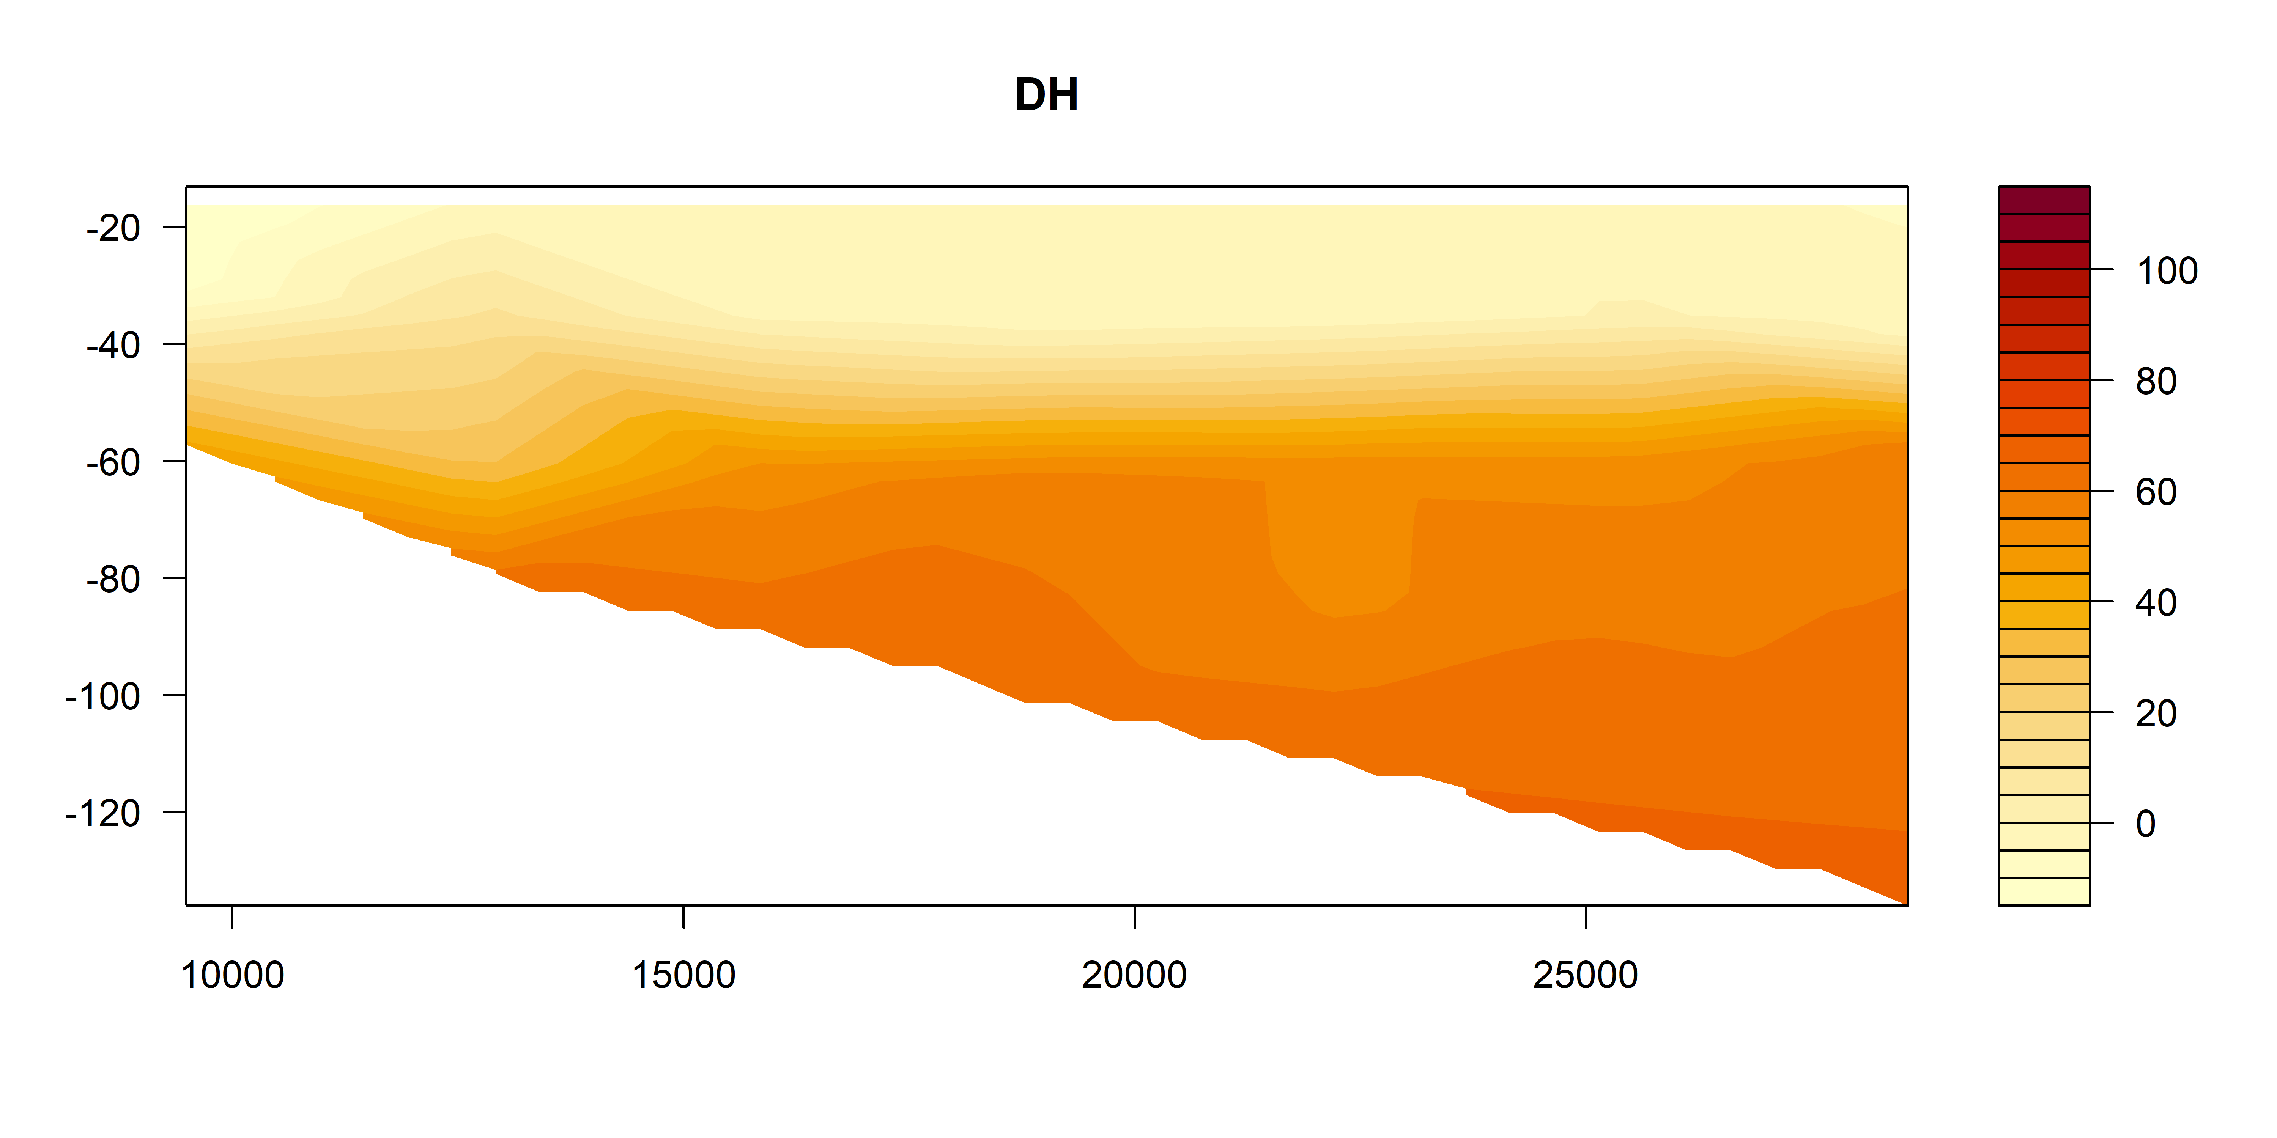
Oxygen utilisation (expected – observed)
um/kg
Positive = respiration (lower O₂)
Negative = photosynthesis / production
um/kg
um/kg

Slide 13
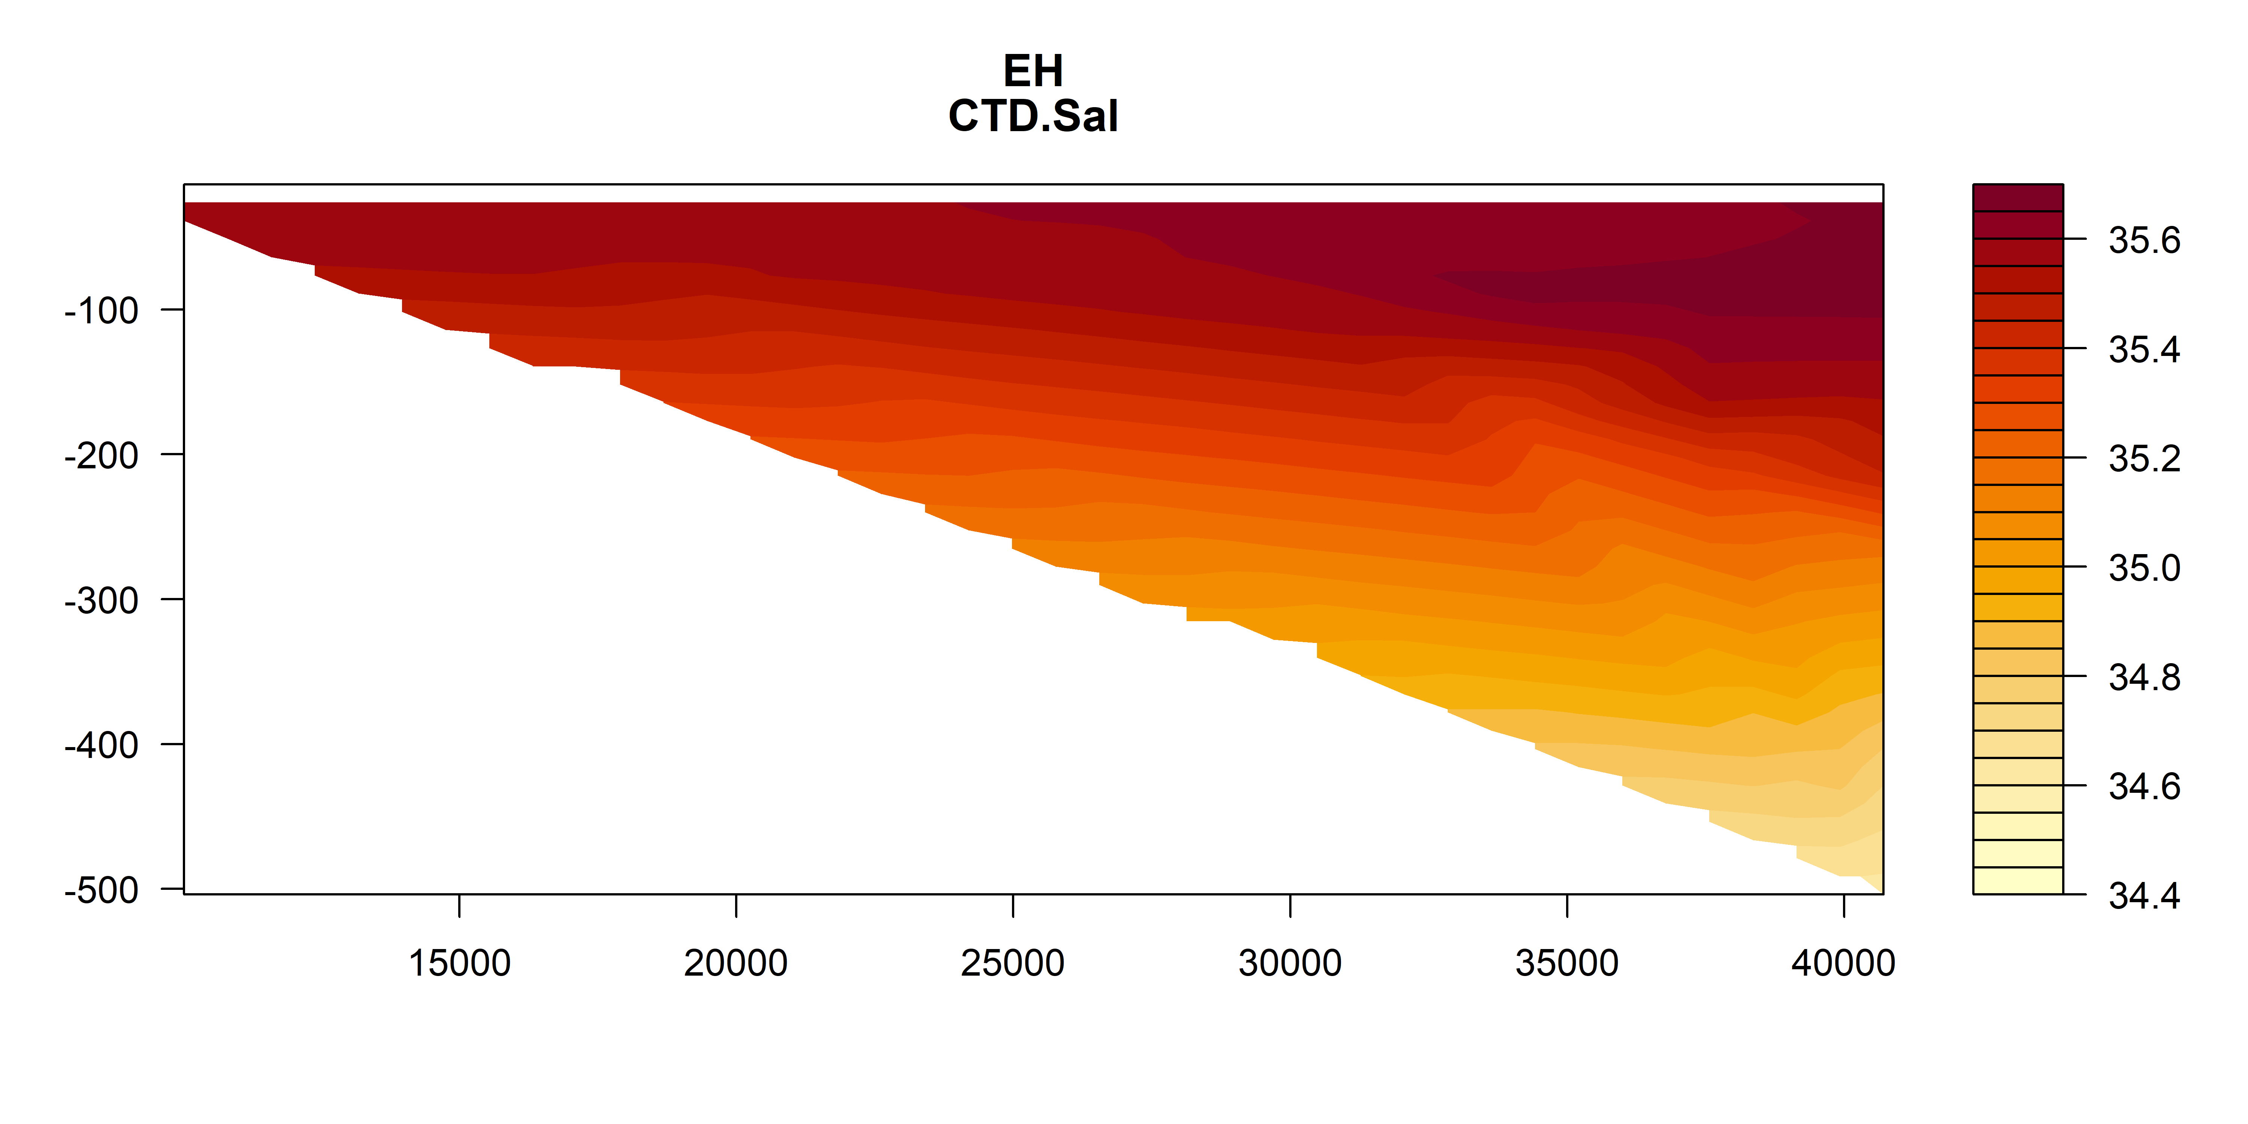
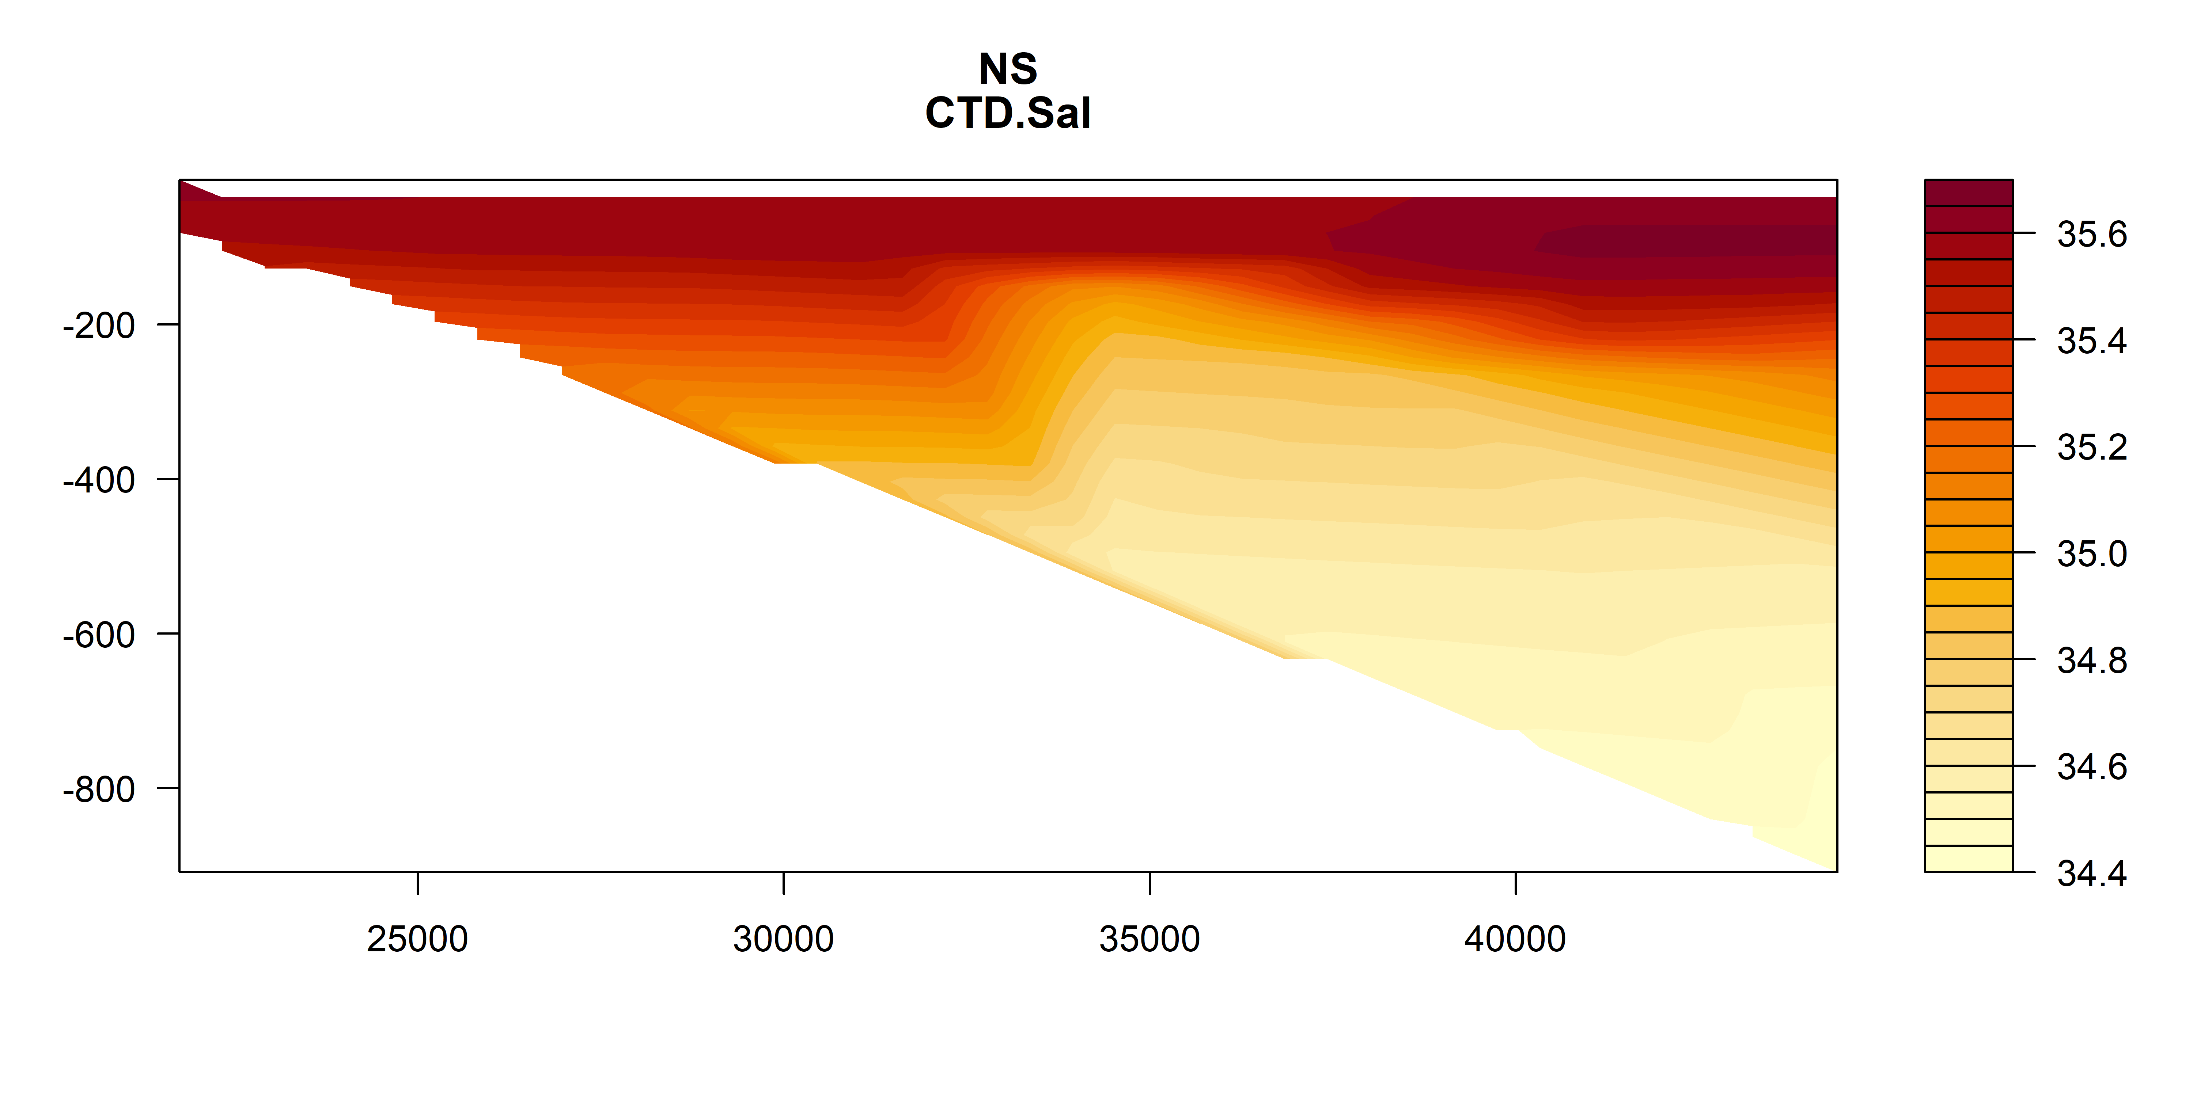
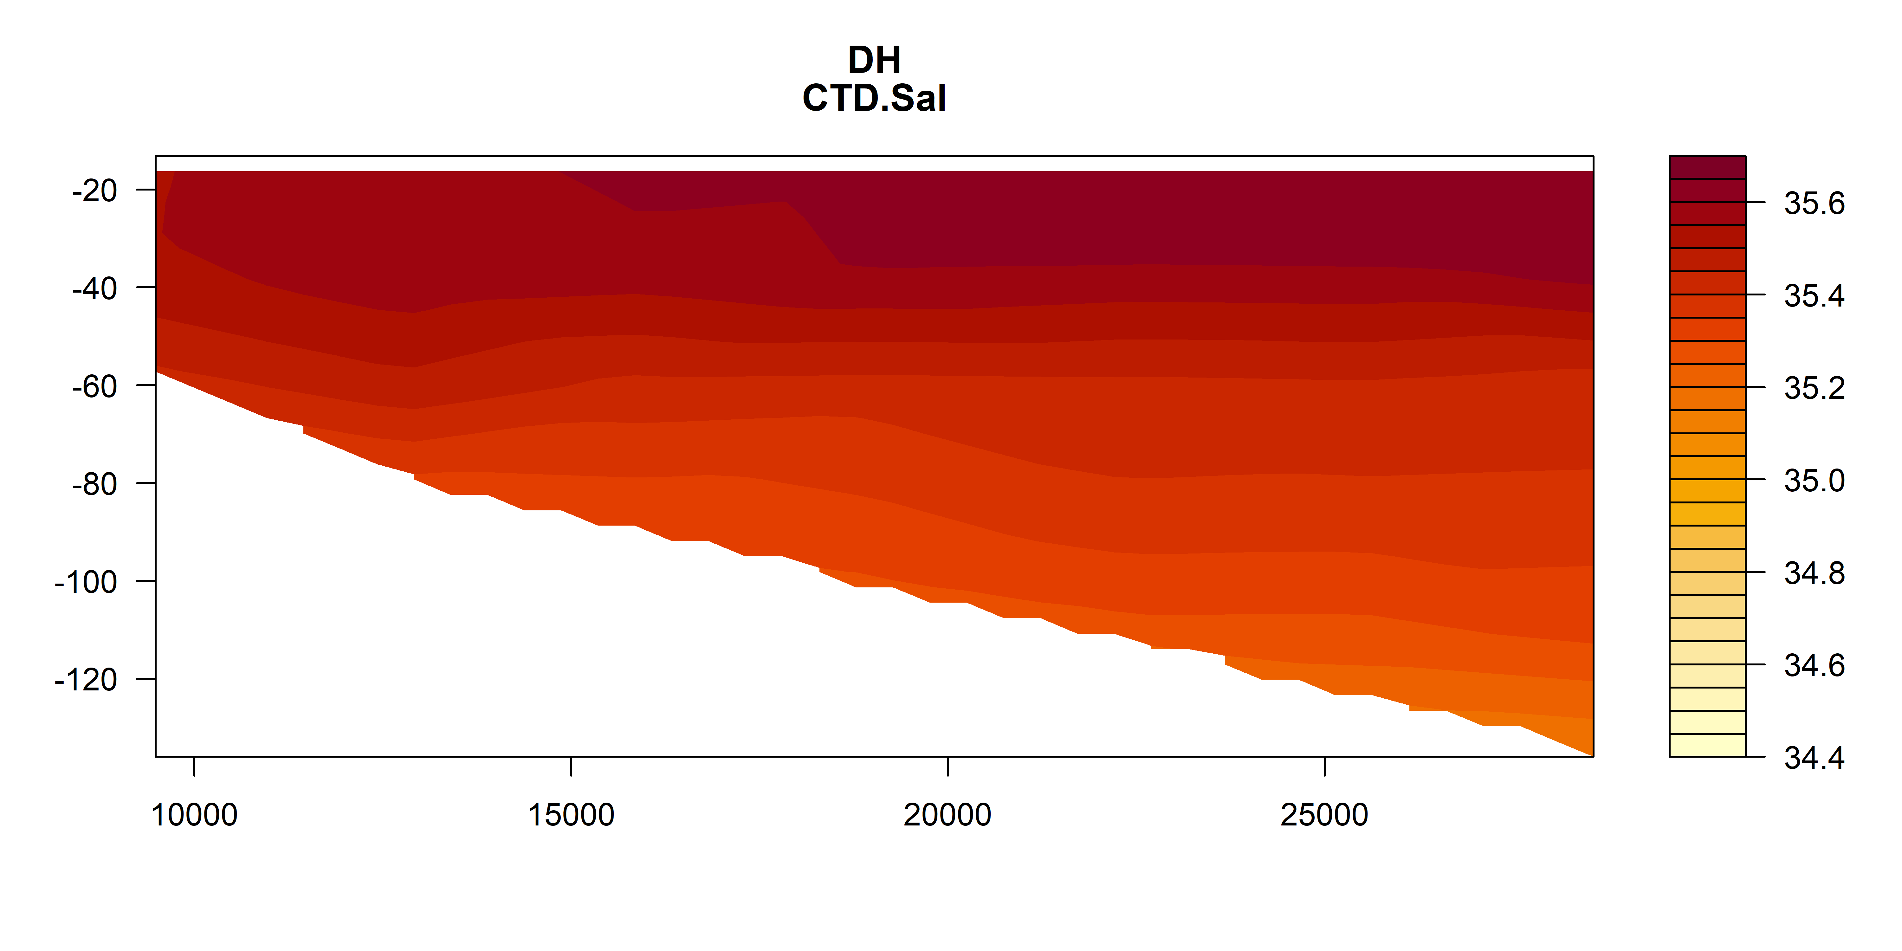
Salinity

Slide 14
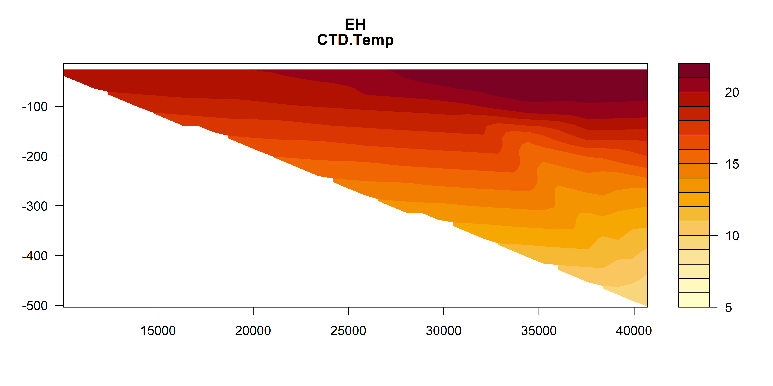
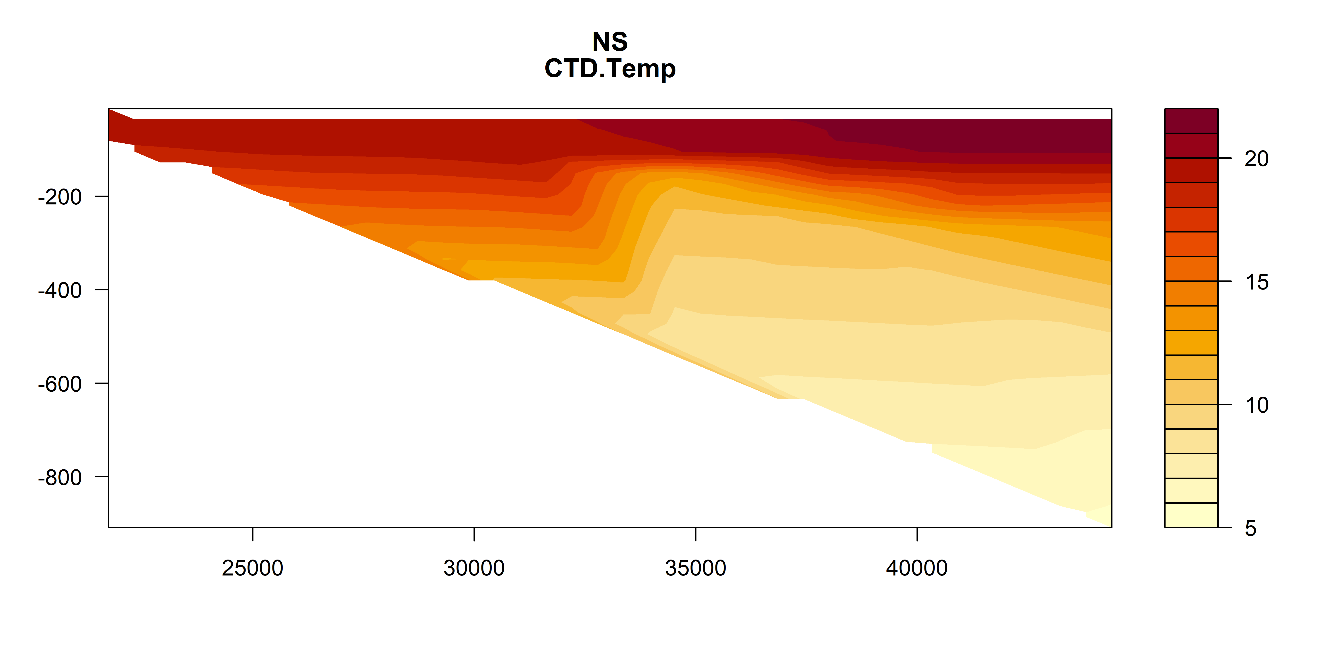
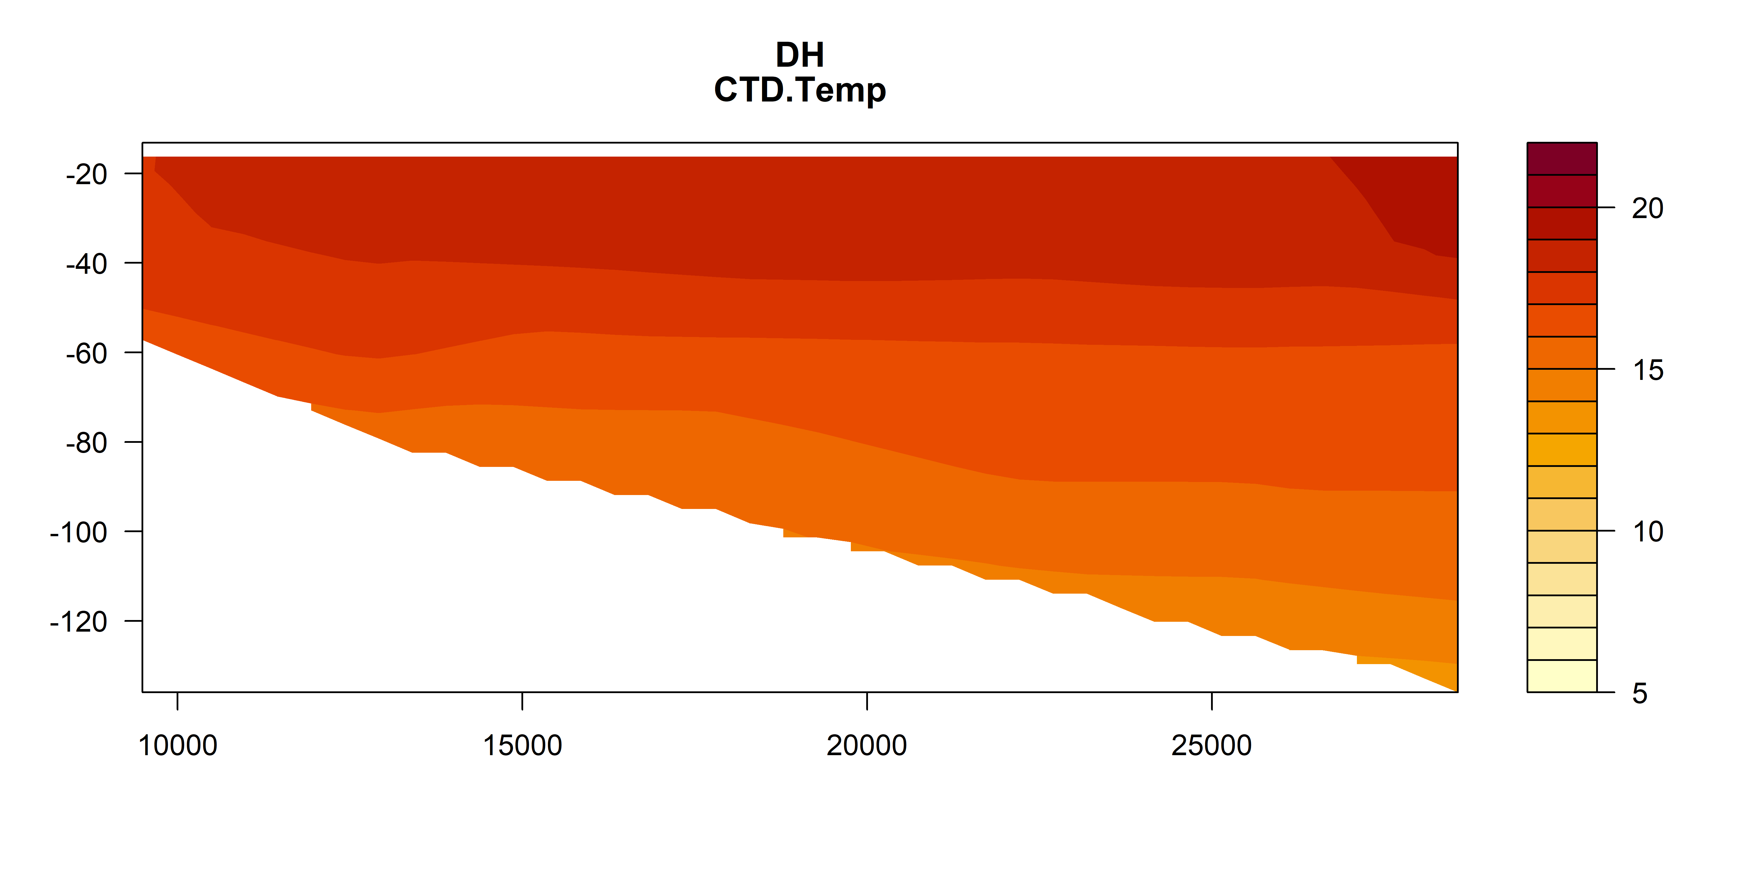
Temperature
Deg C
Deg C
Deg C

Slide 15
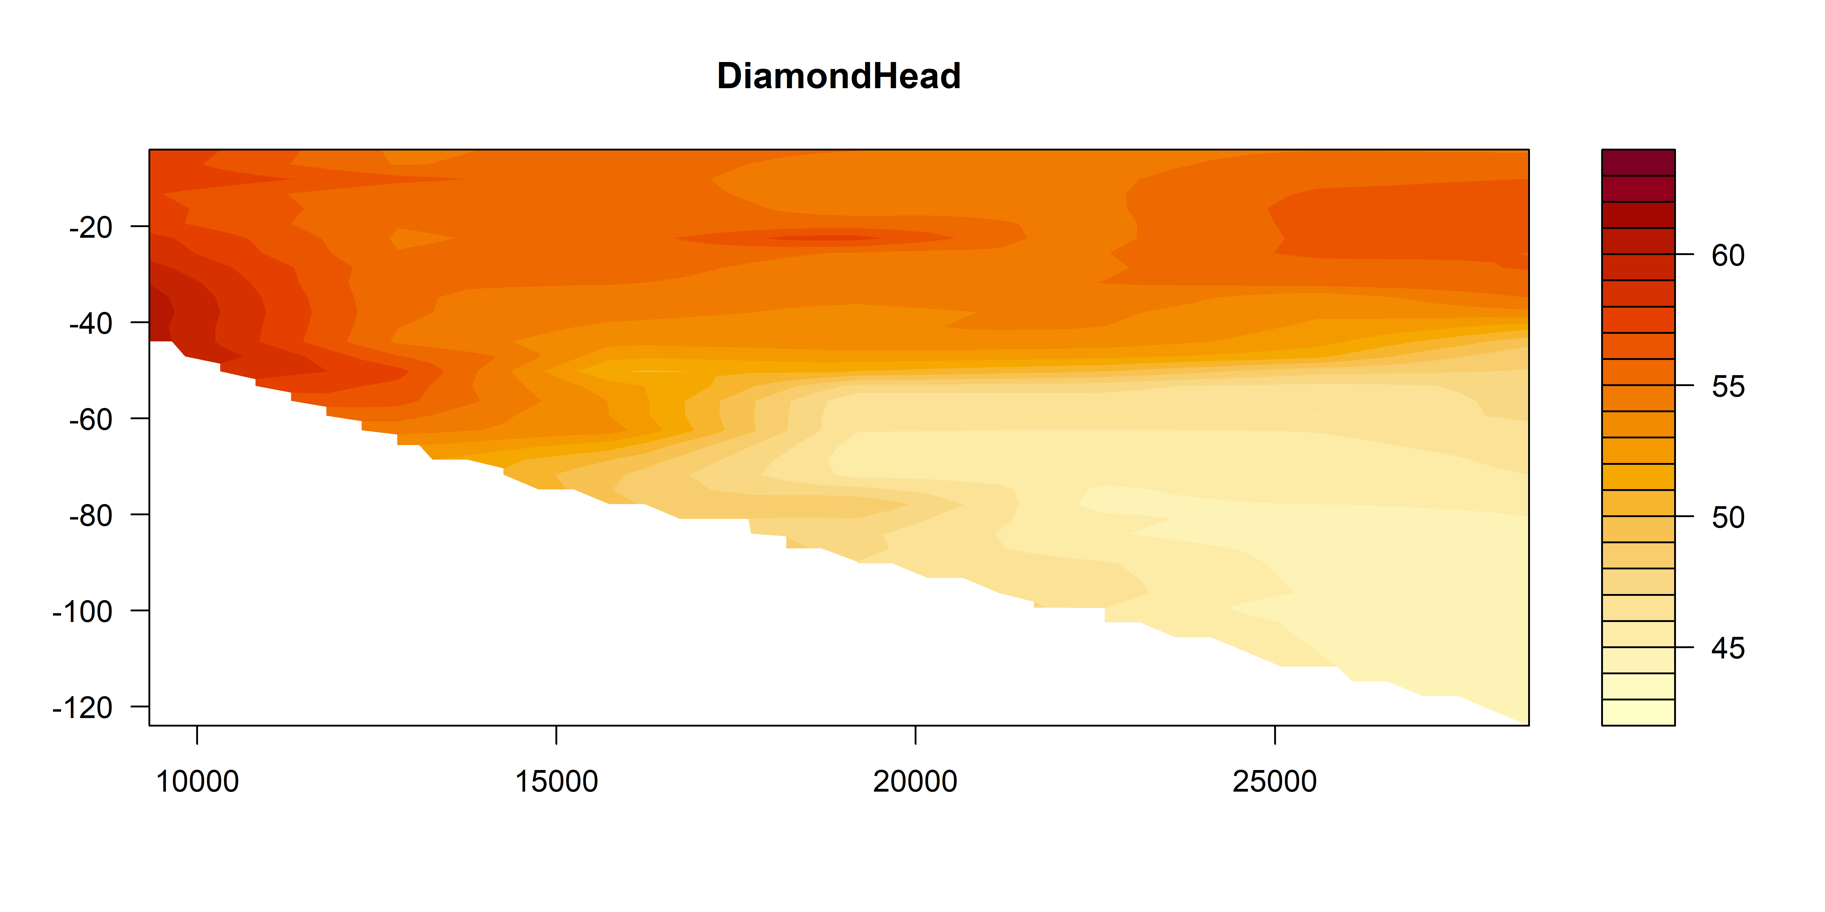
Fluoro

Slide 16
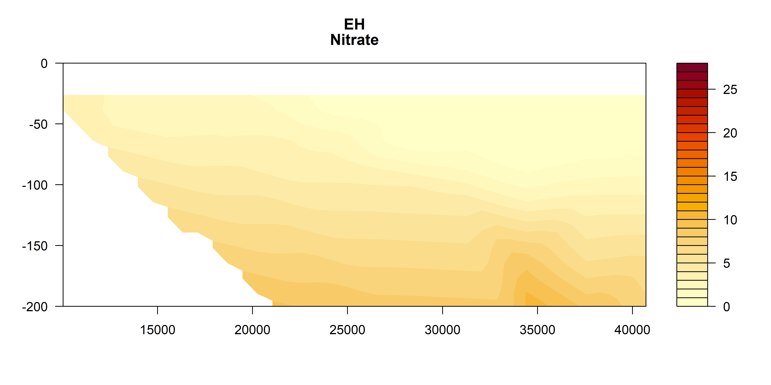
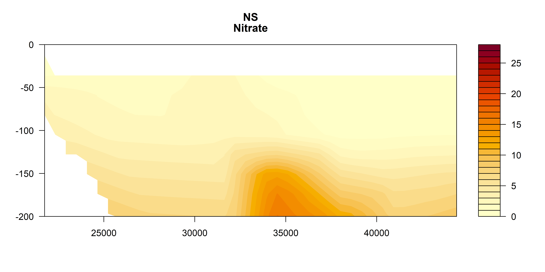
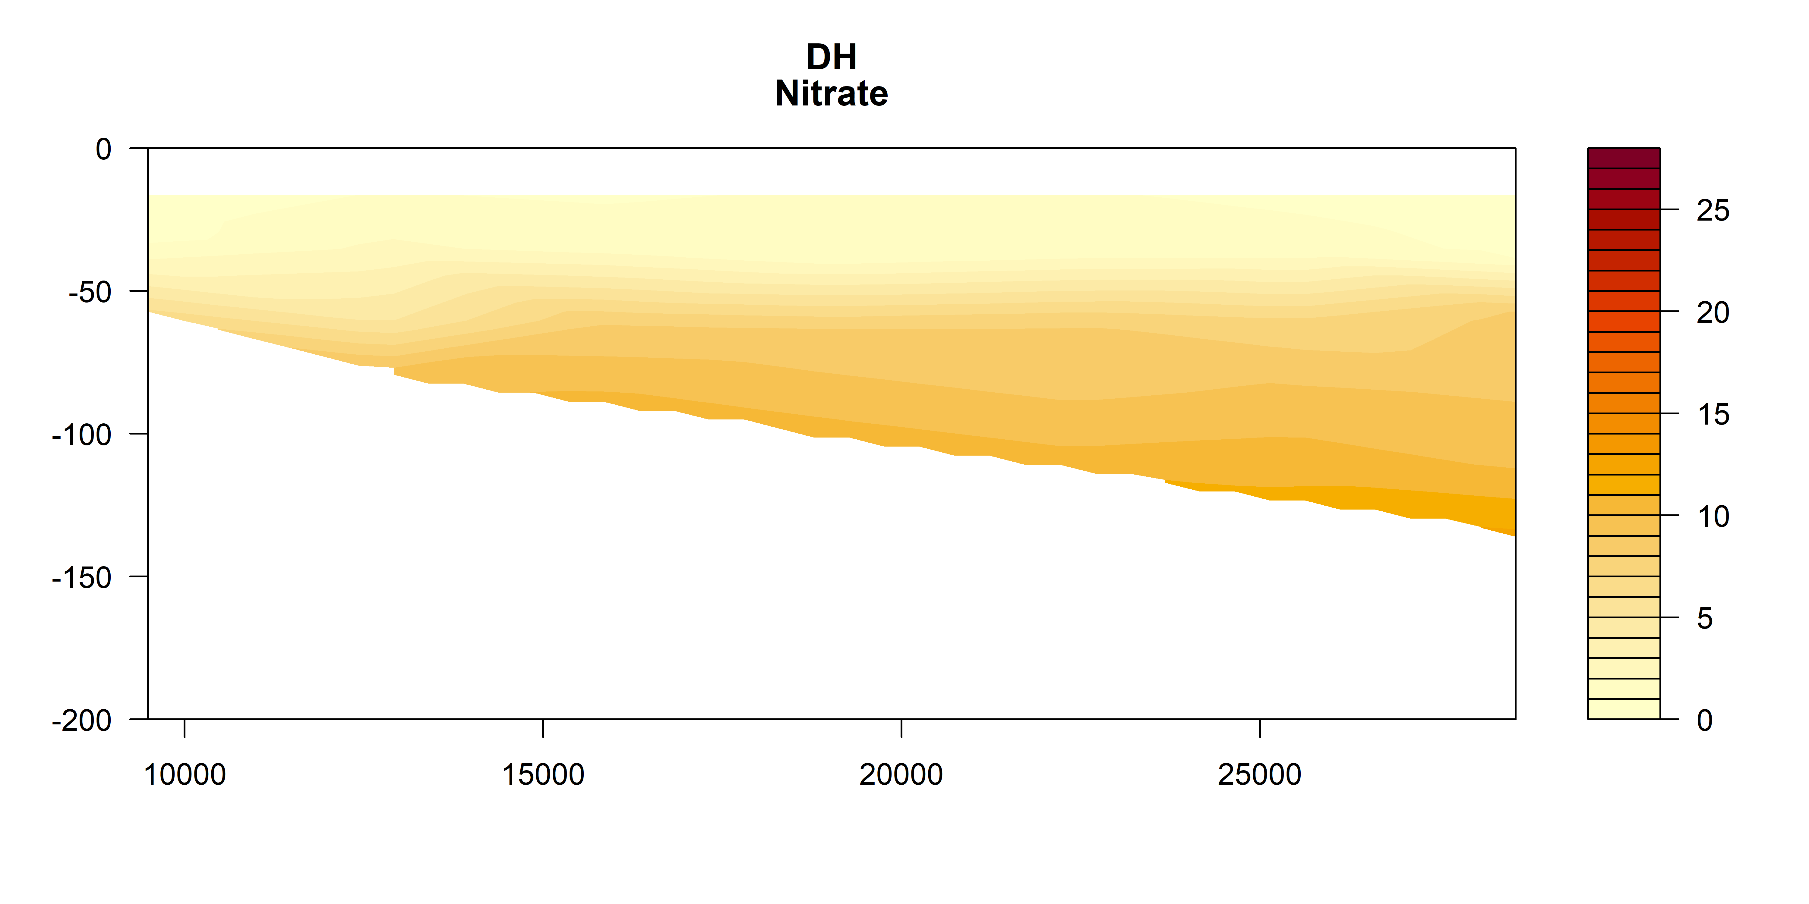
Nitrate

Slide 17
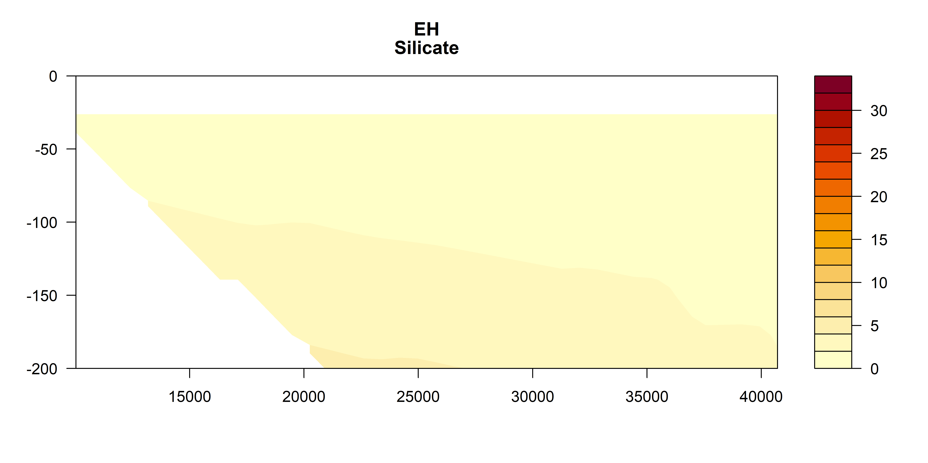
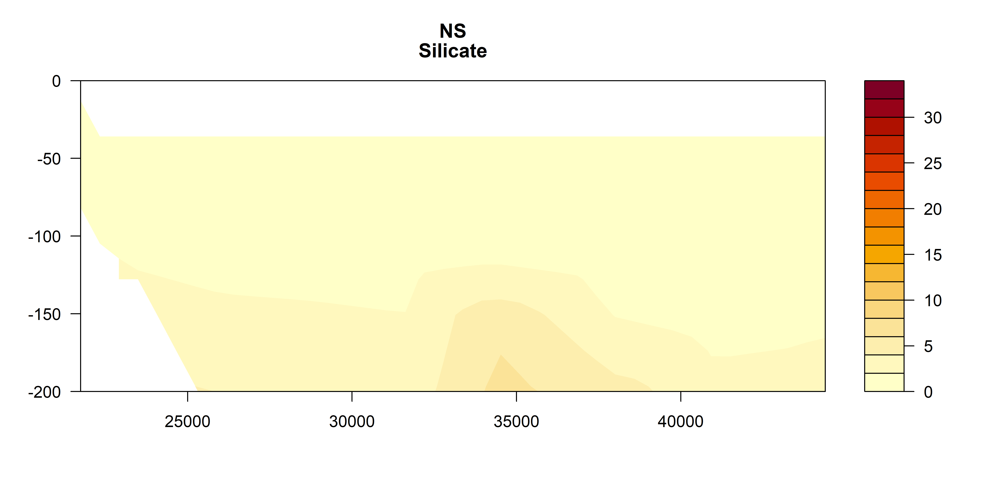
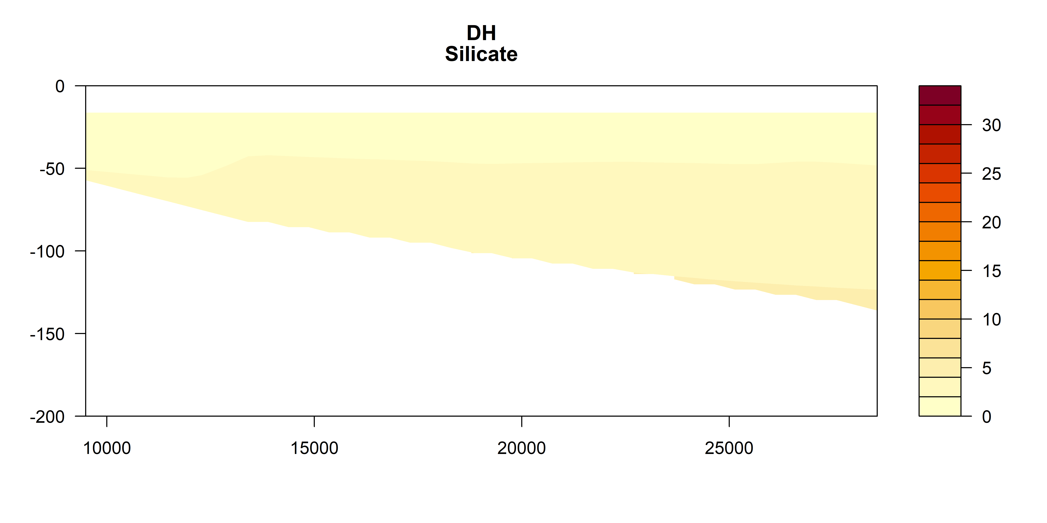
Silicate

Slide 18
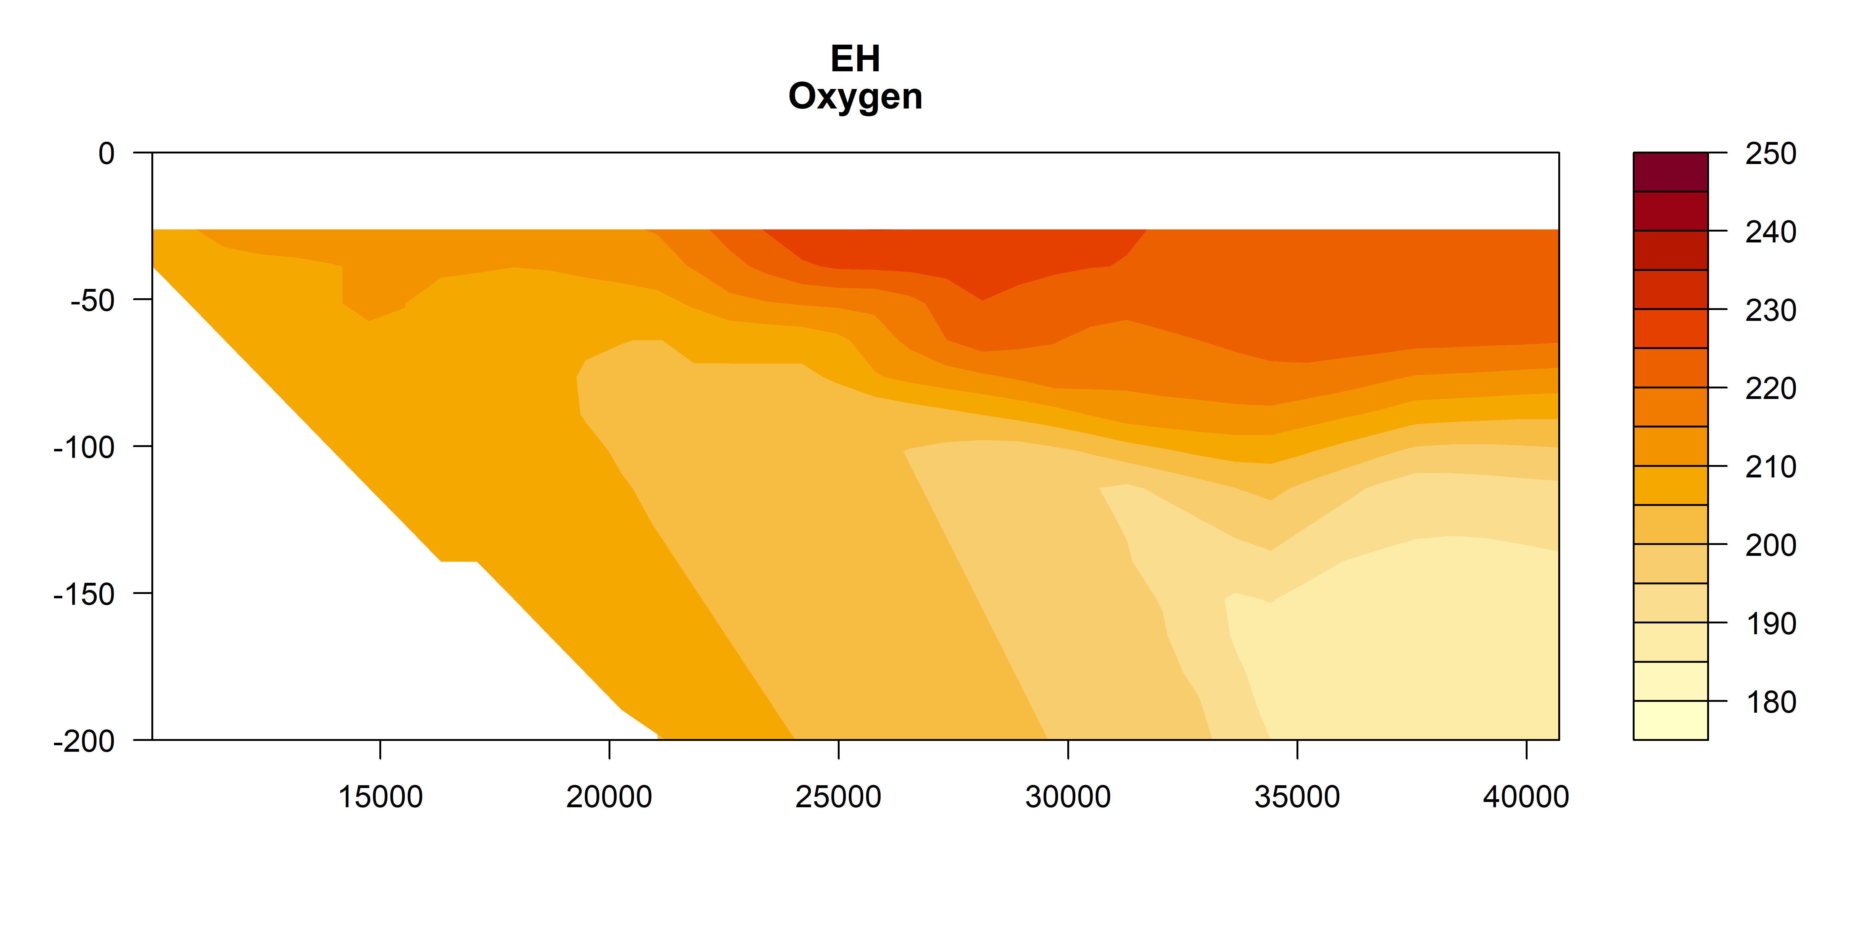
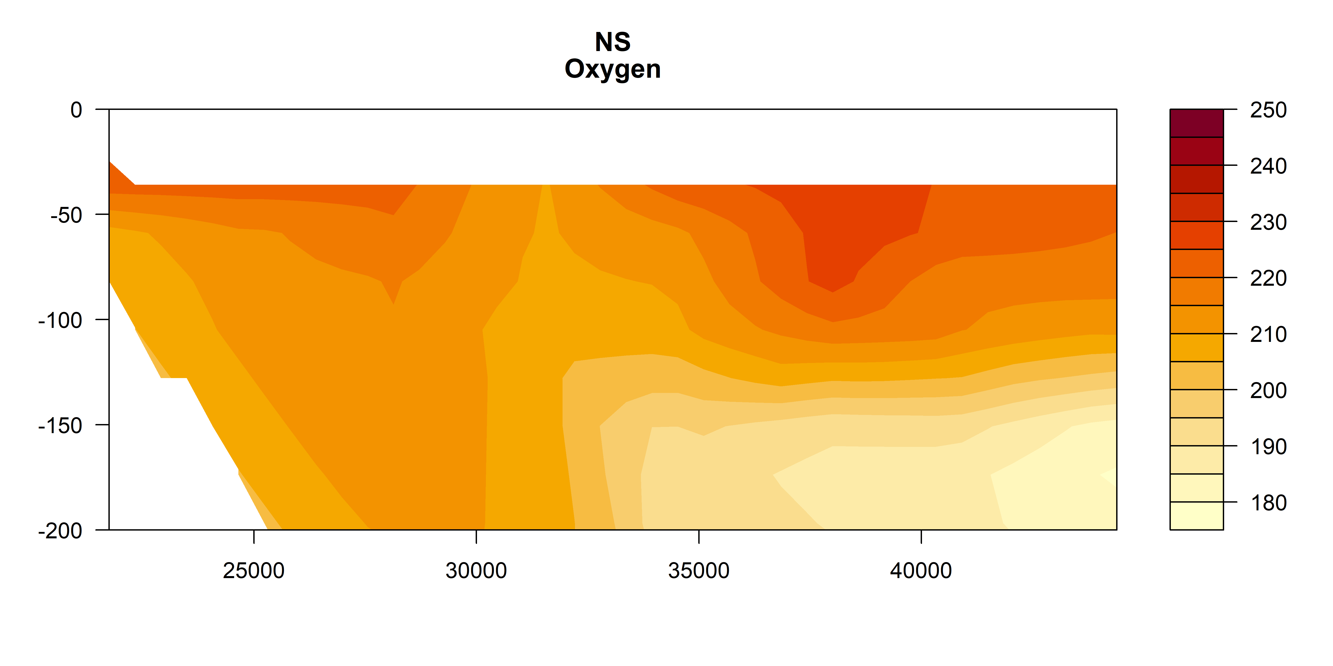
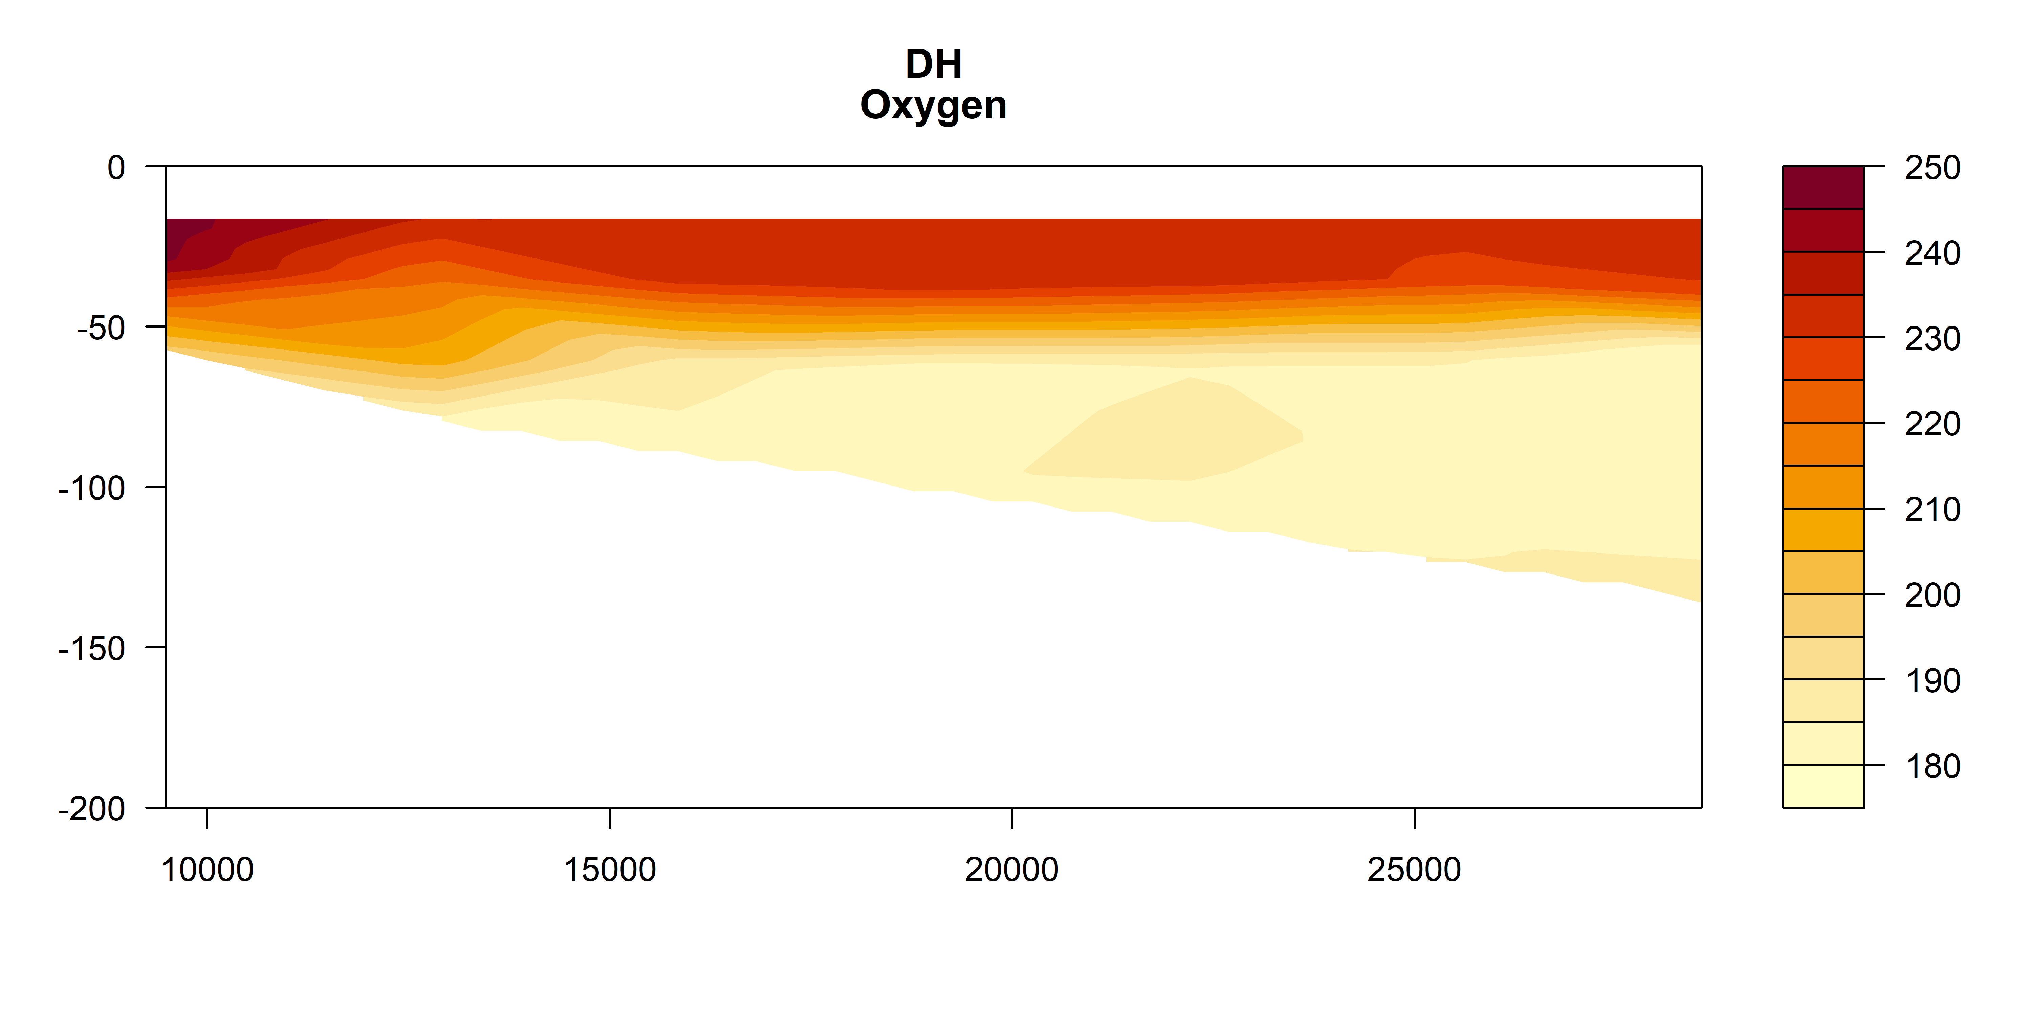
Oxygen

Slide 19
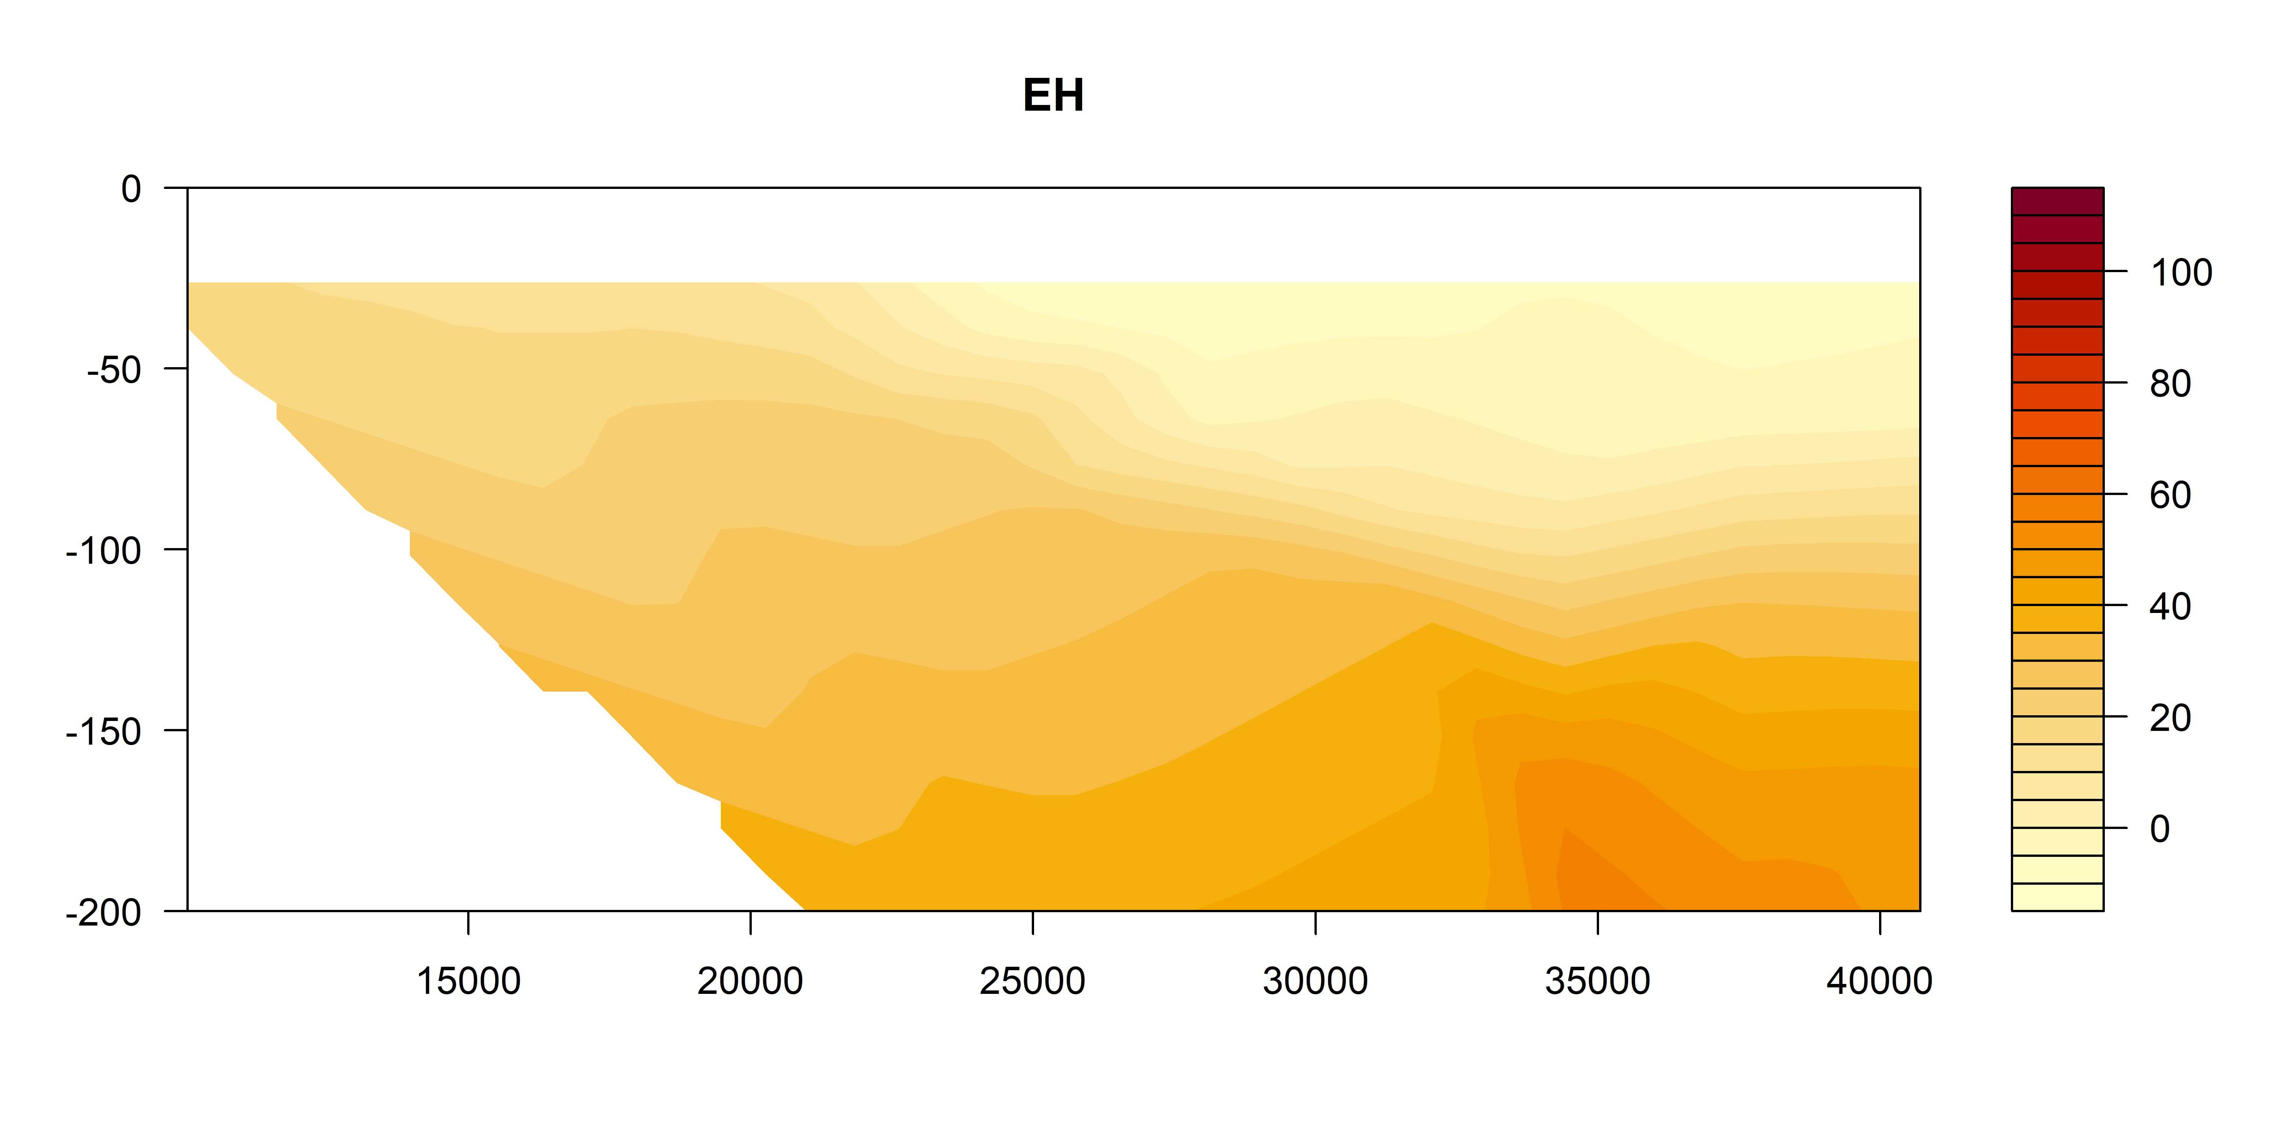
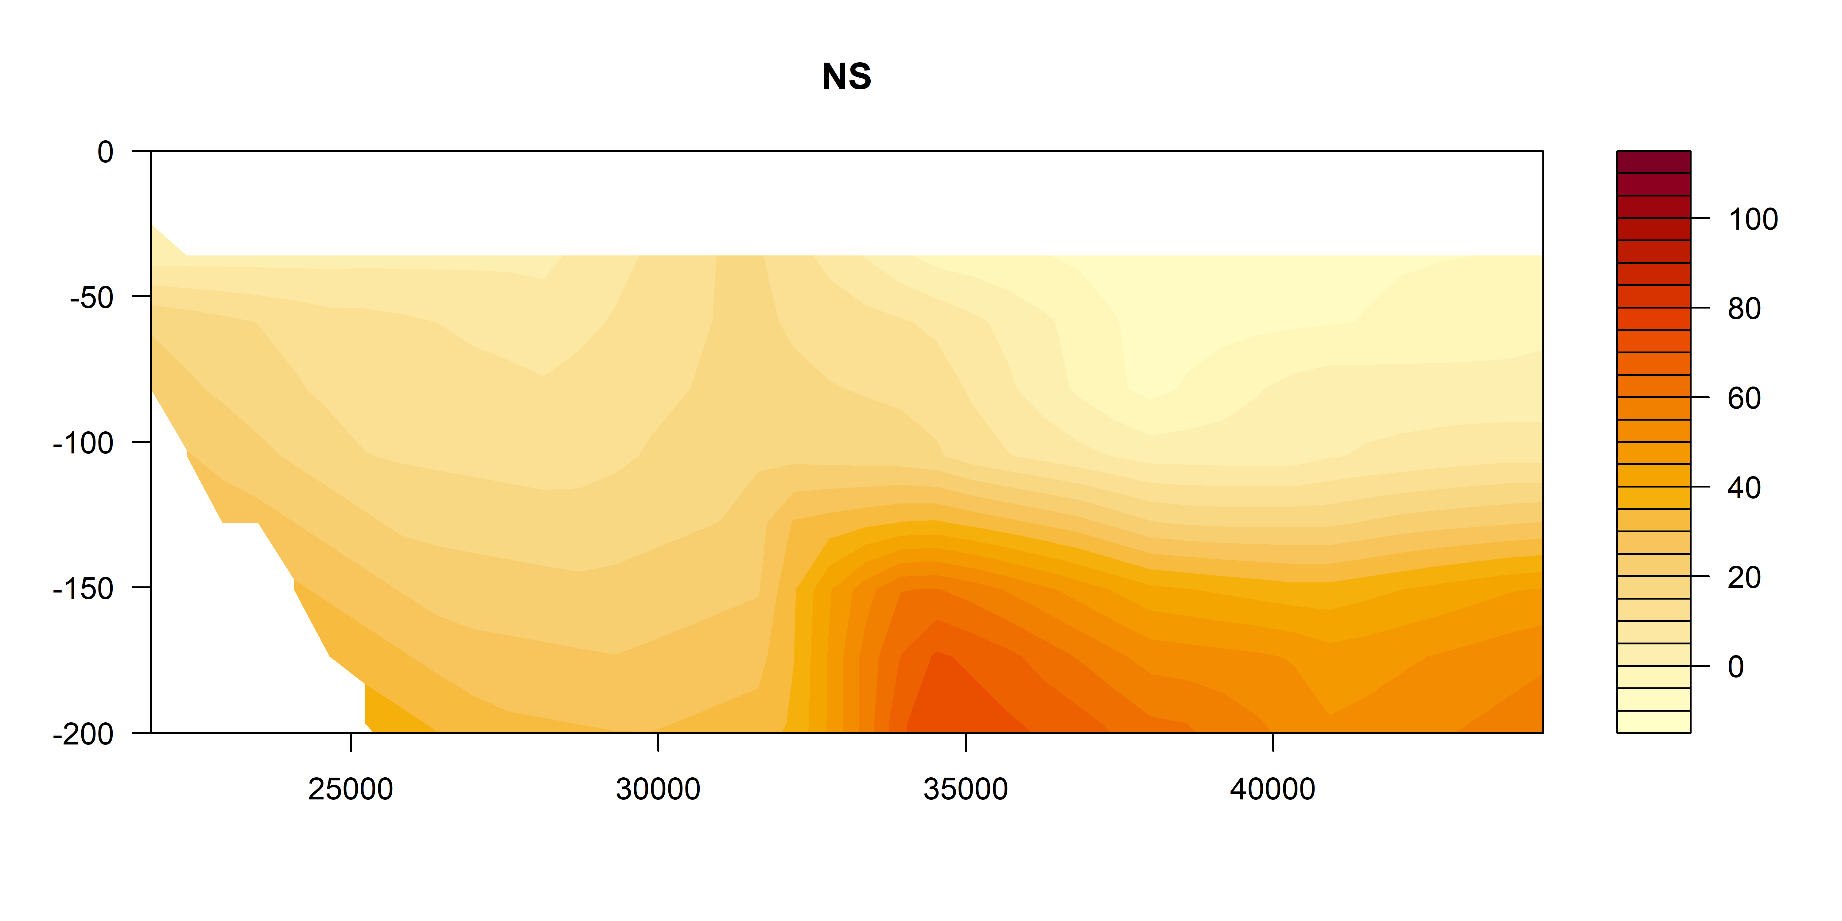
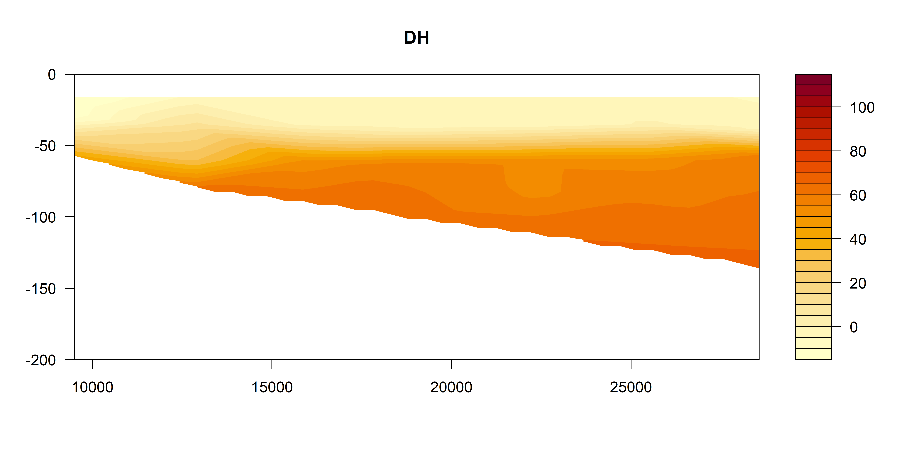
Oxygen utilisation (top 200m)
um/kg
Positive = respiration (lower O₂)
Negative = photosynthesis / production
um/kg
um/kg

Slide 20



Salinity

Slide 21



Temperature

Slide 22

Zooplankton Biomass temperature contours

Slide 23




Zooplankton Biomass

Slide 24




NBSS Slope

Slide 25




Pareto Slope

Slide 26

Abundance

Slide 27




Abundance

Slide 28




Geometric Mean Size

Slide 29
Expectations
Areas of upwelling should have higher nutrients and plankton abundance
Areas offshore (open ocean water) should have slopes closer to -1
Southern sites should have higher biomass (colder water influence)

Slide 30
Patterns
Inshore North Solitary shows some upwelling + higher nutrients + biomass
North Solitary, Evans Head and Cape Byron have high surface biomass offshore (but not abundance?) – this is weird Data error
Abundance (and biomass) increases towards the shelf (I think this is common but relatively unpublished?)

